Slide 1
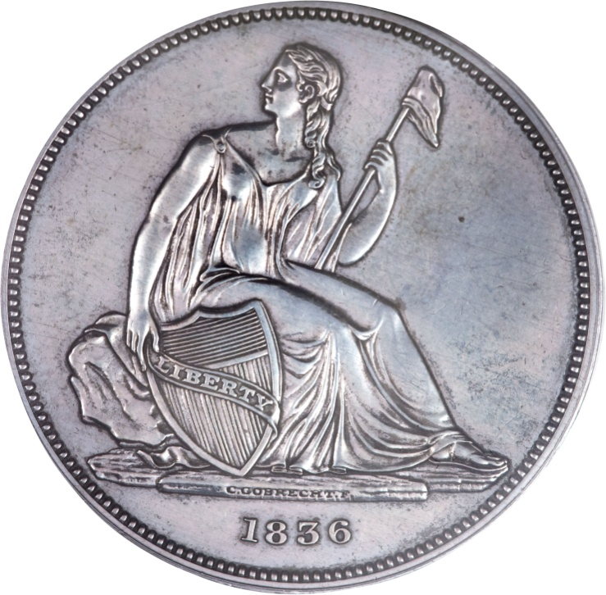
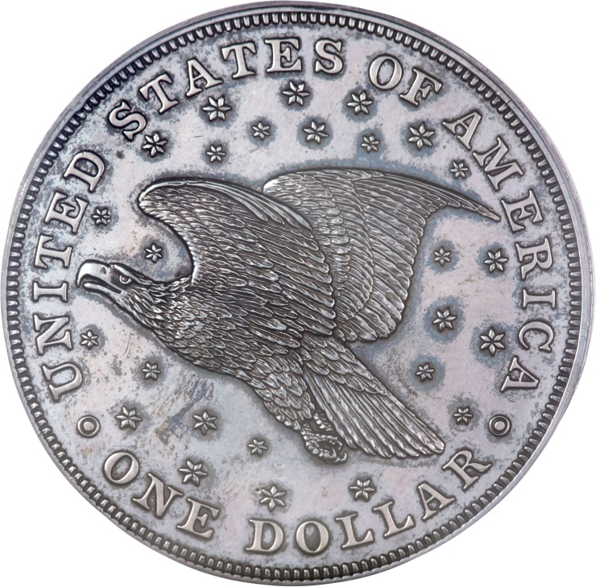
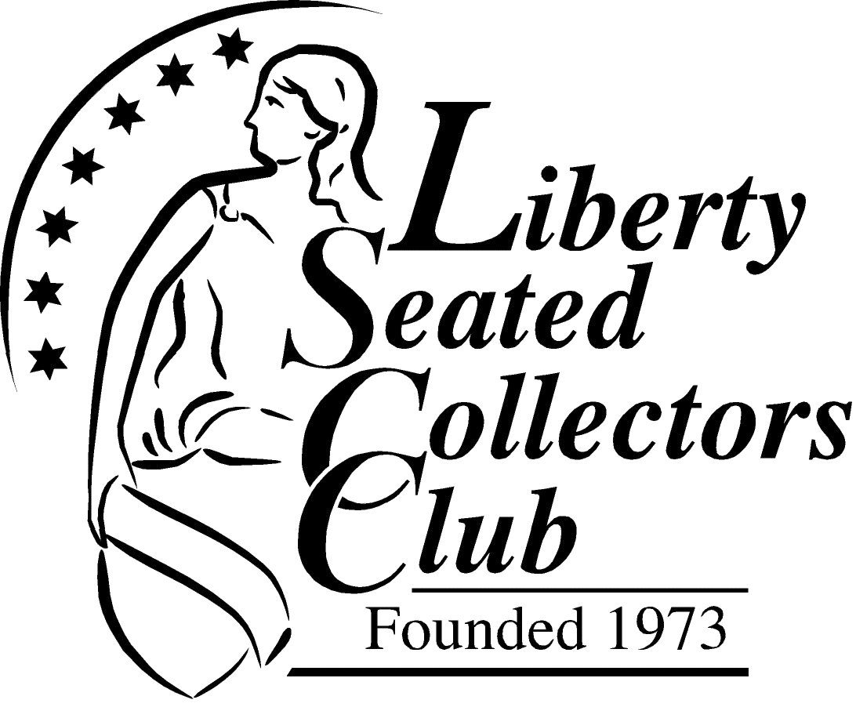
The Andrew Jackson-Earl-Sevier Flying Eagle Dollar
Len Augsburger
Notes:
This is an update to part of the presentation given in Baltimore last November. The story has advanced to a conclusion, and this presentation summarizes the chronology and the final result.

Slide 2
Chronology
August, 2010: A non-collector, Midge S. of Carlisle, PA, discovers 1836 Gobrecht dollar in mother’s safety deposit box
September, 2010: Midge contacts coin dealer Rich Uhrich
Rich advises slabbing, coin comes back PCGS PR62
October, 2010: Rich sells coin at Philadelphia show
Coin passes through one or more intermediaries
Notes:
In August, 2010, a non-collector named Midge discovers an 1836 Gobrecht Dollar in her mother’s safety deposit box. Not being a coin collector, Midge isn’t sure what the coin represents. She assumes the coin was given to the family by an aunt.
The next month, Midge finds her way to local dealer Rich Uhrich, who examines the coin. After telling her the approximate value of the coin, he recommends the coin be certified and encapsulated, both for its protection and eventual sale.
At the Philadelphia coin show in October 2010, Rich Uhrich sells the coin on Midge’s behalf. The coin subsequently passes through one or more intermediaries to a collector.
Fast forward a year: following her mother’s passing, Midge cleans out her mother’s safety deposit box in September 2011. In the family Bible, Midge finds an old letter tucked inside that gives the history of the coin. What she reads shocks her…

Slide 3
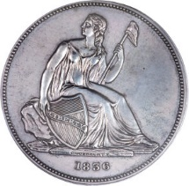
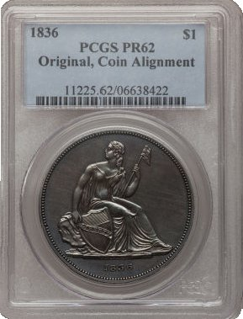
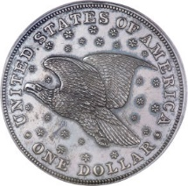
The Coin
Notes:
In August, 2010, a non-collector named Midge discovers an 1836 Gobrecht Dollar in her mother’s safety deposit box. Not being a coin collector, Midge isn’t sure what the coin represents. She assumes the coin was given to the family by an aunt.
The next month, Midge finds her way to local dealer Rich Uhrich, who examines the coin. After telling her the approximate value of the coin, he recommends the coin be certified and encapsulated, both for its protection and eventual sale.
At the Philadelphia coin show in October 2010, Rich Uhrich sells the coin on Midge’s behalf. The coin subsequently passes through one or more intermediaries to a collector.
Fast forward a year: following her mother’s passing, Midge cleans out her mother’s safety deposit box in September 2011. In the family Bible, Midge finds an old letter tucked inside that gives the history of the coin. What she reads shocks her…

Slide 4
The next year…
September, 2011:
Midge cleans out safety deposit box, finds old letter from 1888 tucked in family Bible that gives history of the coin
Notes:
In August, 2010, a non-collector named Midge discovers an 1836 Gobrecht Dollar in her mother’s safety deposit box. Not being a coin collector, Midge isn’t sure what the coin represents. She assumes the coin was given to the family by an aunt.
The next month, Midge finds her way to local dealer Rich Uhrich, who examines the coin. After telling her the approximate value of the coin, he recommends the coin be certified and encapsulated, both for its protection and eventual sale.
At the Philadelphia coin show in October 2010, Rich Uhrich sells the coin on Midge’s behalf. The coin subsequently passes through one or more intermediaries to a collector.
Fast forward a year: following her mother’s passing, Midge cleans out her mother’s safety deposit box in September 2011. In the family Bible, Midge finds an old letter tucked inside that gives the history of the coin. What she reads shocks her…

Slide 5
Sevier Letter of Transmittal, 1888
Sarah K. Sevier to Robert S. Dunbar, Jr. (grandson), 3/21/1888:
“The dollar was given to your mother on one of my visits to the ‘Hermitage,’ the home of General Jackson. The coin was given to your mother by Major R.E.W. Earl who was a friend of General Jackson & member of his household. I believe the dollar was given to Major Earl by General Jackson as the first impression of the Silver dollars made or coined when General Andrew Jackson was President. I have understood there were only a few made perhaps only one dozen, indeed I have been told the Coin Book says there were only six made but I never saw a coin book and don’t know but whether there few or many made. The dollar you have is one of the number and was given to your mother in 1837 when she was an infant, by Major Earl…”
Notes:
In the letter to Robert Dunbar from Sarah Sevier in 1888, the history of the dollar is told.
The Gobrecht Dollar was given to Robert Dunbar’s mother in 1837 when she was an infant, by Major R.E.W Earl, when they visited Andrew Jackson’s home, The Hermitage. Earl was a friend of Andrew Jackson and part of his household. Earl was given the coin by Andrew Jackson. Jackson was President at the time the dollars were struck.
The letter says Sarah Sevier believed the coin was the first impression made, or certainly at least one of the first pieces coined.
--------------
This obviously was a shock to Midge, who had sold the coin the previous year, not knowing any of this. She was distraught at having sold off such a historical piece, and an important part of her family heritage.

Slide 6
The Andrew Jackson Collection
American Journal of Numismatics, April 1872:
Among the relics at the "Hermitage," Nashville, Tenn., which formerly belonged to General Andrew Jackson, are a number of coins; among which are a Washington Half Dollar, 1792, and a Pine Tree Two-pence, 1762 [sic, 1662 is intended]. They were presented to General Jackson by Mr. John Guest, Jan. 27, 1837.
General Gates P. Thruston, American Journal of Numismatics, Oct. 1892:
The writer obtained for his collection a number of coins and medal that originally belonged to the Jackson cabinet. Among them was the “Eric canal medal” in gold…Among the other objects I obtained from the Jackson collection, were two beautiful flying eagle dollars of the year 1836, with the mint luster still untarnished, showing the care with which they had been preserved. According to the label, in the handwriting of Mrs. Jackson, one had been presented by Mr. Patterson [Director] of the Mint, as “one of the first dollars stamped.” The other was presented by Martin Van Buren to a member of the Jackson family, as shown by its label…I also obtained from the same collection, the rare silver piece known as the “Washington [Getz] half dollar.”
Notes:
Some notes on Andrew Jackson and his collection...
Apparently Andrew Jackson was a collector of sorts. Found in the Hermitage were a number of significant coins, including a Washington half dollar pattern, a 1652 Pine Tree two-pence, both presented to the President in 1837 by John Guest.
Another tie-in to Andrew Jackson by General Gates P. Thruston…
Thruston obtained coins and a medal that originally belonged to Andrew Jackson, including two 1836 Gobrecht Dollars (with mint lusture untarnished). The label was in Mrs. Jackson’s handwriting, stating one of these was presented to Jackson by Mint Director Patterson as one of the first struck. The other was presented by Martin Van Buren to a member of the Jackson family. The Washington [Getz] Half Dollar came from the same source.
Thus, two different sources corroborate the fact that numerous numismatic items, including Gobrecht Dollars, had been given to Andrew Jackson.

Slide 7
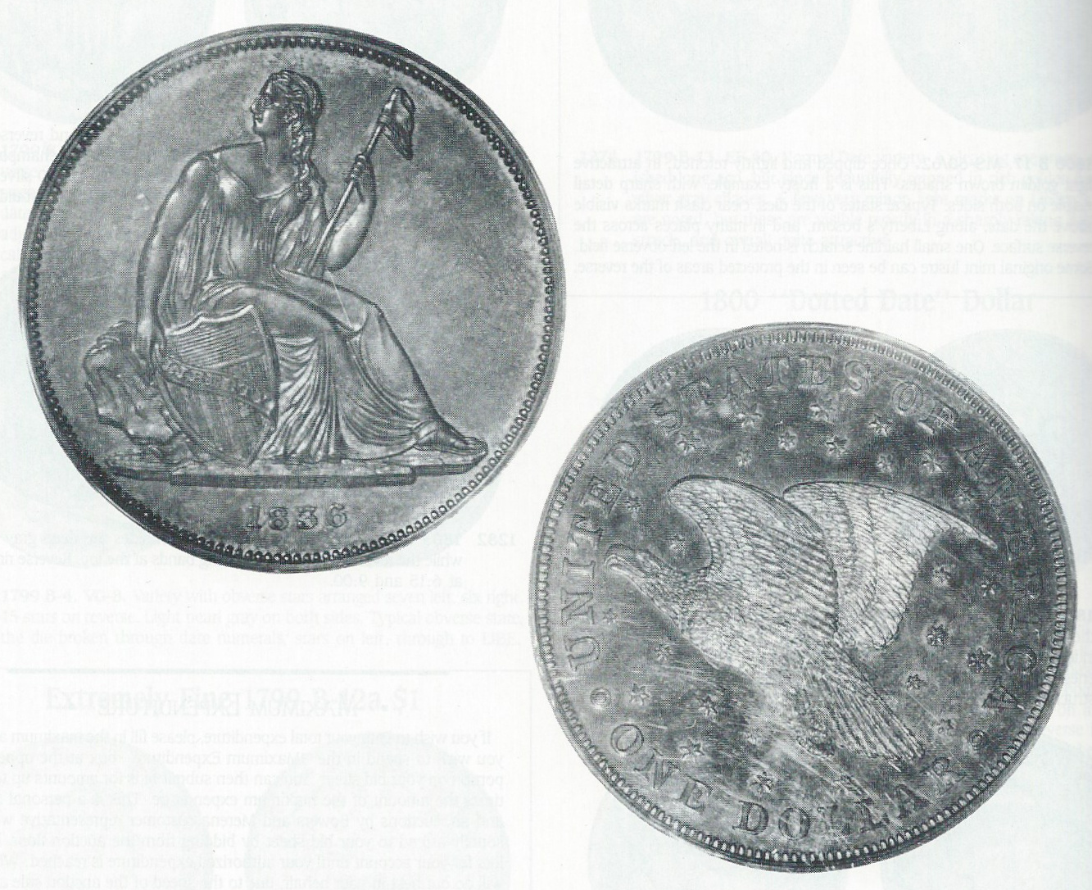
Jackson – Thruston Gobrecht Dollar
1892: First mentioned in the American Journal of Numismatics
1910: Lyman Low sale #147 includes:
Lot 120: Gobrecht Dollar presented by Mr. Patterson
Lot 366: Erie Canal medal with case inscribed to Jackson
1934: Bluestone sale #13 includes Thruston Gobrecht dollar
1992: Bowers & Merena 1/1992, lot 1283 ($18,700) now PCGS PR63
Notes:
The pedigree of the “other” Gobrecht Dollar, the one obtained by General Thruston from Andrew Jackson is shown here.
First mentioned in the American Journal of Numismatics in 1892, the Jackson-Thruston dollar presented to Jackson by Patterson was included in the Lyman Low sale of 1910, along with an Erie Canal Medal.
Subsequent sales included the 1934 Bluestone sale, and the 1992 Bowers and Merena sale. The catalog included a copy of letter/label:
Flying eagle Dollar 1836,
One of the first dollars of the new stamp coined in Phila. Presented by R. Patterson of the mint __ 1836

Slide 8
Andrew Jackson & Numismatics
Jackson approved the Gobrecht dollar design, per a letter from the Secretary of the Treasury to the Mint Director, 1/8/1836
Numismatic News, 12/15/2009 – Gobrecht dollar inscribed “A. Jackson to J. W. McGrath”
Possibly ex. Stack’s
Notes:
More on President Jackson…
According to a letter from the Treasury Secretary to Mint Director Robert Patterson, it was Andrew Jackson that approved the “Flying Eagle” dollar design, January 8, 1836
Also, according to Numismatic News, another Gobrecht Dollar was inscribed “A. Jackson to J.W. McGrath”
It is possible that this dollar was sold in a Stacks sale, but nobody remembers when that might have been, so no auction archive has been found

Slide 9
Chronology
October 2011: Rich Uhrich connects LenA and Midge S
Midge furnishes scan of certified coin - LenA searches Heritage archive for match
October 2011: LenA identifies coin in Heritage sale, 1/2011 (FUN 2011), realized $21,861.50
November, 2011: LenA discusses coin with Todd Imhof, Heritage principal - Imhof indicates coin has resold since the auction, and current owner does not wish to sell
LenA asks Heritage to let him know if the coin becomes available
Notes:
Now back to the story…
In September 2011, After Midge had found the letter in the family Bible, she contacted Rich Uhrich, hoping she could find the coin and reacquire the family heirloom. Rich put her in touch with Len Augsburger. She furnished a scan of the Gobrecht Dollar to Len, who searched the Heritage Archives, to see if he could find a match.
Len identified that the same coin had indeed sold in the FUN Heritage Sale in January 2011, just 3 months after Midge had sold the coin.
In November 2011, Len discussed with one of the Heritage principals, about the desire to locate the coin. At this time, Len did not mention the letter about the Gobrecht Dollar, trying to avoid a situation where this knowledge would make the coin harder to obtain, if it could be found. Todd Imhof, the Heritage principal, let Len know that the coin had been resold since the auction, and that the current owner did not wish to sell the coin.
Three years later, in October 2014, Len Augsburger presented the story at the LSCC meeting in Baltimore, hoping the publicity would eventual result in the coin coming back to Midge.
Quite literally the next day, in Baltimore, Len noticed a familiar-looking Gobrecht Dollar in a PCGS PR62 holder. He knew he had seen it before. Could it be the same coin? He checked the Heritage Archives for Midge’s coin, and confirm that it was the same coin. He contacted Midge, who confirmed she did want to re-acquire the coin.
Len brokered the sale and the coin was reunited with Midge, the letter, and the family Bible. In March 2015, the story was told in The Gobrecht Journal, #122.

Slide 10
Chronology
October, 2014: LenA presents the sad story to the Liberty Seated Collectors Club meeting at the Baltimore coin show
March, 2015: Story is published in Gobrecht Journal #122
That same afternoon, LenA notices that very coin at the Baltimore show in a dealer’s case
Len A subsequently brokers transaction to Midge S
Notes:
Now back to the story…
In September 2011, After Midge had found the letter in the family Bible, she contacted Rich Uhrich, hoping she could find the coin and reacquire the family heirloom. Rich put her in touch with Len Augsburger. She furnished a scan of the Gobrecht Dollar to Len, who searched the Heritage Archives, to see if he could find a match.
Len identified that the same coin had indeed sold in the FUN Heritage Sale in January 2011, just 3 months after Midge had sold the coin.
In November 2011, Len discussed with one of the Heritage principals, about the desire to locate the coin. At this time, Len did not mention the letter about the Gobrecht Dollar, trying to avoid a situation where this knowledge would make the coin harder to obtain, if it could be found. Todd Imhof, the Heritage principal, let Len know that the coin had been resold since the auction, and that the current owner did not wish to sell the coin.
Three years later, in October 2014, Len Augsburger presented the story at the LSCC meeting in Baltimore, hoping the publicity would eventual result in the coin coming back to Midge.
Quite literally the next day, in Baltimore, Len noticed a familiar-looking Gobrecht Dollar in a PCGS PR62 holder. He knew he had seen it before. Could it be the same coin? He checked the Heritage Archives for Midge’s coin, and confirm that it was the same coin. He contacted Midge, who confirmed she did want to re-acquire the coin.
Len brokered the sale and the coin was reunited with Midge, the letter, and the family Bible. In March 2015, the story was told in The Gobrecht Journal, #122.

Slide 11
Reunited!
Notes:
A photo of the Andrew Jackson-Earl-Sevier, with the family Bible and the Letter.
Midge has made sure that her family knows the heritage, pedigree, and historical significance of the Dollar, to ensure that they are never separated again.

Slide 12
www.LSCCweb.org
Questions?

