Slide 1
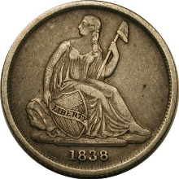
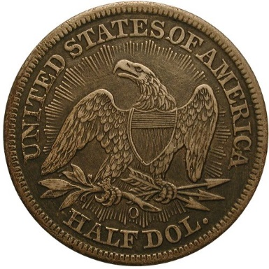
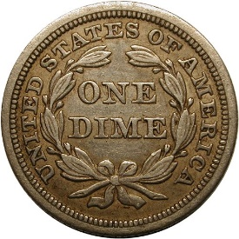
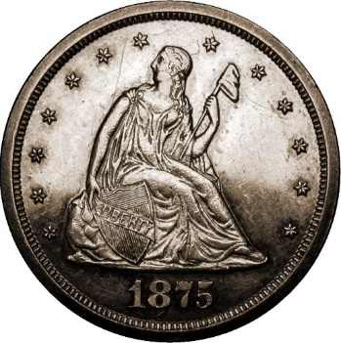
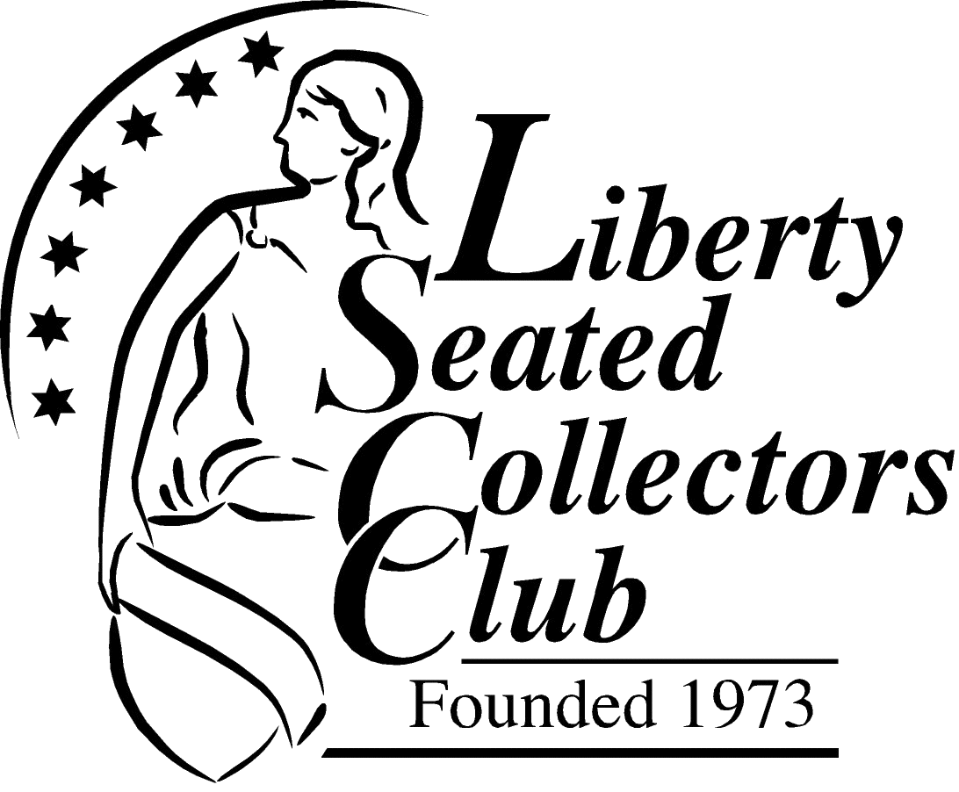
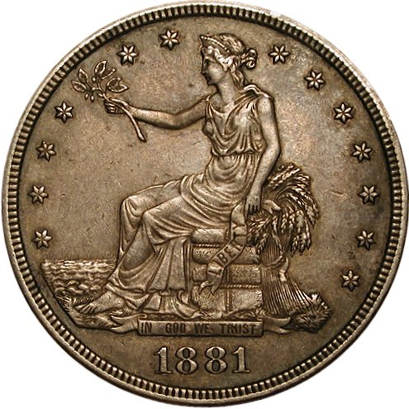
Introduction to Liberty Seated Coinage
Notes:
This presentation will give an introduction to the Liberty Seated Collectors Club (LSCC) and will provide a detailed overview of each of the 7 Liberty Seated series, Half Dimes to Trade Dollars.

Slide 2
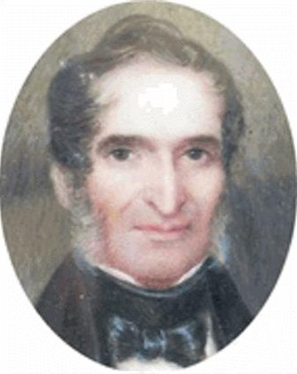
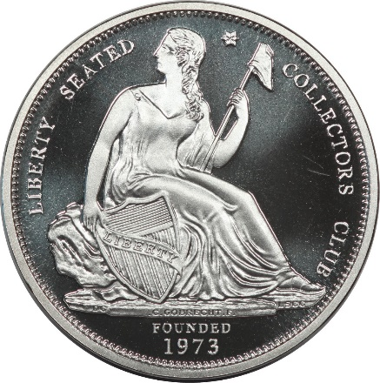
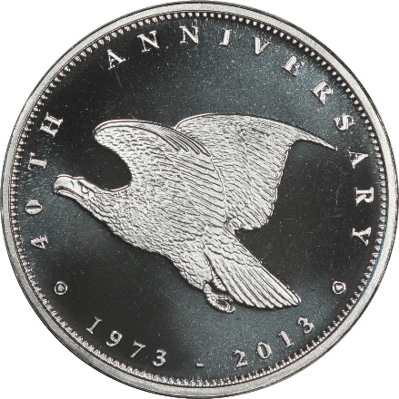
Liberty Seated Collectors Club
Founded during 1973 in Bal Harbour, Florida
Kam Ahwash and John McCloskey past presidents
600+ members who enjoy seated coinage
Liberty Seated coinage experts
Research, education and social interactions
Dues are $25 per year.
~ 20 Regional Meeting events per year
2019 – 2020 Officers
Gerry Fortin, President
Len Augsburger, Vice President
Dale Miller, Secretary/Treasurer
Bill Bugert, Publications Editor
Notes:
The LSCC has been a vibrant club for more than 40 years, when Kam Ahwash and a few other collectors and dealers of Liberty Seated coinage realized the need for a specialty club to educate the collectors of the rich series of Liberty Seated coinage.
Today, the LSCC has well over 600 members all over the country. Members include a wide range, including the recognized experts in the different series, beginning collectors, and everything in between. And the experts are only too happy to share their knowledge with others. If one thing sets the LSCC apart, it is a very welcoming organization.
The LSCC provides its members research information, a formal education program, meetings and social events all over the country. We currently have about 20 meetings and social events annually, mostly at regional coin shows.
Dues are $25 per year
Our officers include President Gerry Fortin, VP Len Augsburger, and Secretary/Treasurer Dale Miller. Our Publications Editor is Bill Bugert, who publishes two award-winning publications: The Gobrecht Journal, and the monthly electronic E-Gobrecht.

Slide 3
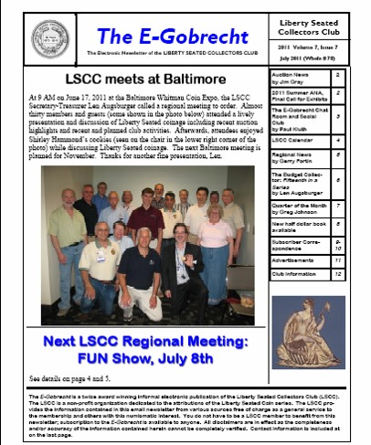
Award-winning Publications
Gobrecht Journal
Published 3 times per year
Bill Bugert, Editor
Detailed Research, Collecting Notes, Club Member Stories
All Color – November 2014
E-Gobrecht
Published Monthly
Bill Bugert, Editor
Club News, Auction Results. Short Articles, Monthly Columns
Quick and Easy Publishing
Notes:
The primary publication is The Gobrecht Journal. 3 issues are published each year, and includes most of the research articles written by members, along with anecdotes and collecting notes. Beginning in November 2014, the Gobrecht Journal is an all-color publication.
The monthly E-Gobrecht is available by email or download from our website, lsccweb .org. The E-Gobrecht contains more time-sensitive items, such as club news, auction results, discovery announcements, and a few monthly columns.
If you are not receiving the E-Gobrecht and you would like to, just give us your email address and we’ll take care of that for you.

Slide 4
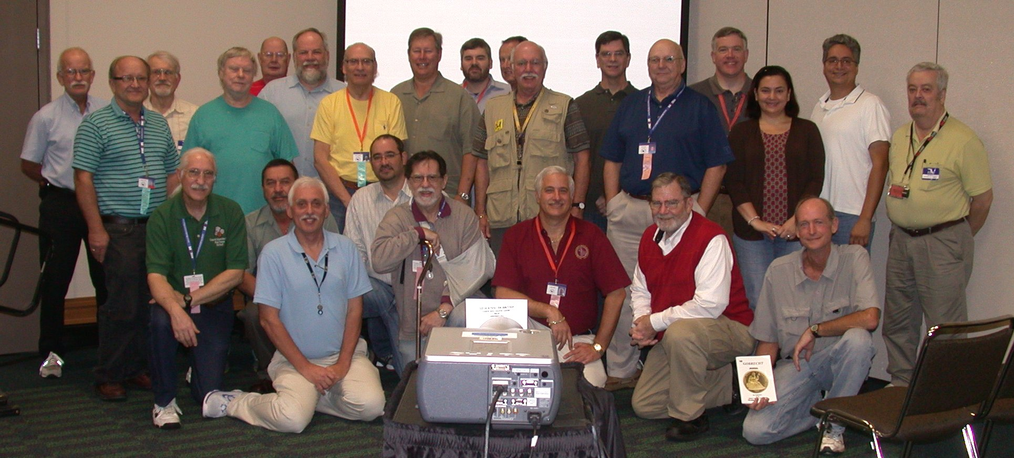
Regional Meetings
Social opportunities
~20 events annually nationwide
  FUN, ANA, Baltimore, Long Beach, CSNS, Manchester NH, Raleigh, Bay State, Ohio State Show, Knoxville, and more
Notes:
The LSCC currently supports about 20 events per year around the country. In addition to our Annual Meeting at the summer ANA, FUN, and other major shows, we are going to more moderate-sized regional shows, holding educational programs (in addition to club updates).

Slide 5
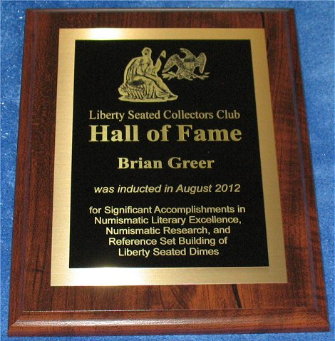
Hall of Fame, Publishing Awards
Hall of Fame recognition
HoF Committee annual review and voting
LSCC HoF Members: Kamal Ahwash, John McCloskey, Al Blythe, Randy Wiley, Brian Greer, Gerry Fortin, Jim O’Donnell, Eugene Gardner, Jim Gray, Len Augsburger, Bill Bugert
Annual publishing awards
Ahwash Award – Best Gobrecht Journal article as voted by membership
E-Gobrecht Editor’s Award – Key contribution to monthly newsletter
Notes:
The LSCC has a Hall of Fame, and the Committee reviews nominations on an annual basis. Past recipients include some of the giants in Liberty Seated coinage.
In our award-winning publications, the LSCC presents awards to major contributors. The club votes on the best article in the Gobrecht Journal, and the E-Gobrecht Editor selects the key contribution to the monthly E-Gobrecht Journal issues over the course of the year.

Slide 6
Christian Gobrecht – 1785-1844
1785: Born in Hanover, PA
Clockmaker, inventor, die maker and engraver
1811: Moved to Philadelphia
1823: Applied for Chief Engraver
1835-1840: Second Engraver
1840-1844: Chief Engraver
Patterns, medals, regular issue Liberty Seated coinage
Notes:
The primary designer known for Liberty Seated coinage is Christian Gobrecht, born in Hanover Pennsylvania.
This is a chronology in his evolution from clockmaker to Chief Engraver of the US Mint.

Slide 7
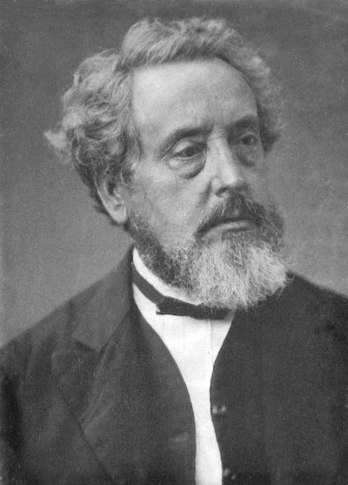
William Barber – 1807-1879
1807: Born in London, England
Father John Barber also an engraver
Moved to U.S. in 1852, engraving in Boston and Providence
Hired by James B. Longacre in 1865
Became Chief Engraver in 1869
Responsible for Trade dollar, double dime, along with many patterns and medals
Died suddenly on August 31, 1879
Notes:
The designer of the twenty-cent piece and Trade Dollar was William Barber, 5th Chief Engraver of the U.S. Mint.
While he only did two circulating coins, both were Liberty Seated. He was also famously skilled at medals and was prolific in the creation of patterns.

Slide 8
Numerous Major Design Sub-types
Vary somewhat by series
No stars on obverse
Stars on obverse
No drapery
Drapery
Arrows at date
Arrows and rays
No Motto
With Motto
Legend on obverse
Notes:
Next, we’ll go through the various design sub-types found on Liberty Seated coinage. There are a number of them, and the different series will include different sets of these sub-types.
We’ll visually show these sub-types to make it easy for you to distinguish them from each other.

Slide 9

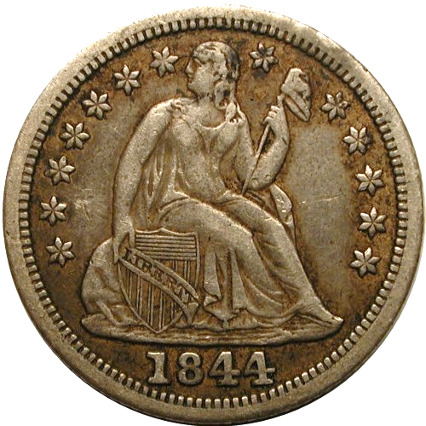
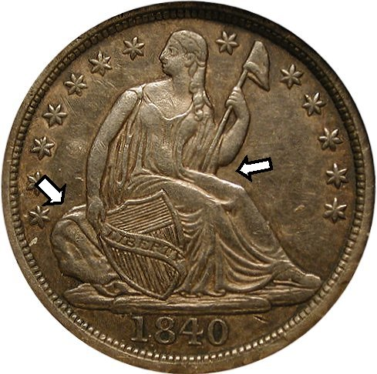
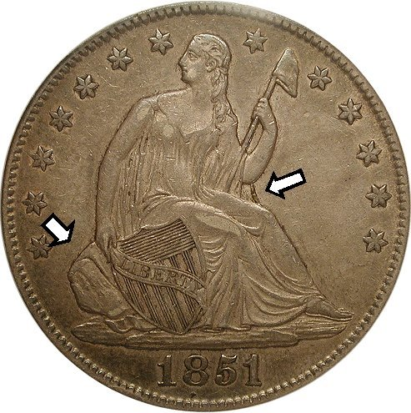
Major Design Sub-types
No stars (1837, 1838-O)
With stars (1838-)
No drapery (1836-1840)
With drapery (1840-)
Notes:
First of all, dimes and half dimes can be found with the No Stars obverse. Beginning in 1838, Stars were added to the obverse.
For most of the Liberty Seated series, the original design included a large rock and no extra drapery under Liberty’s right-facing elbow. In 1840, the rock to the left was made smaller, and extra drapery was added to the right under her elbow.

Slide 10
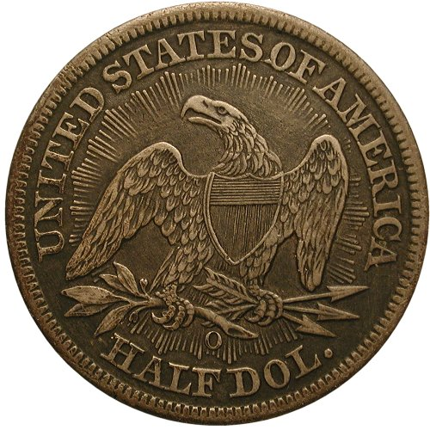
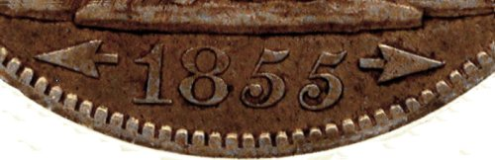
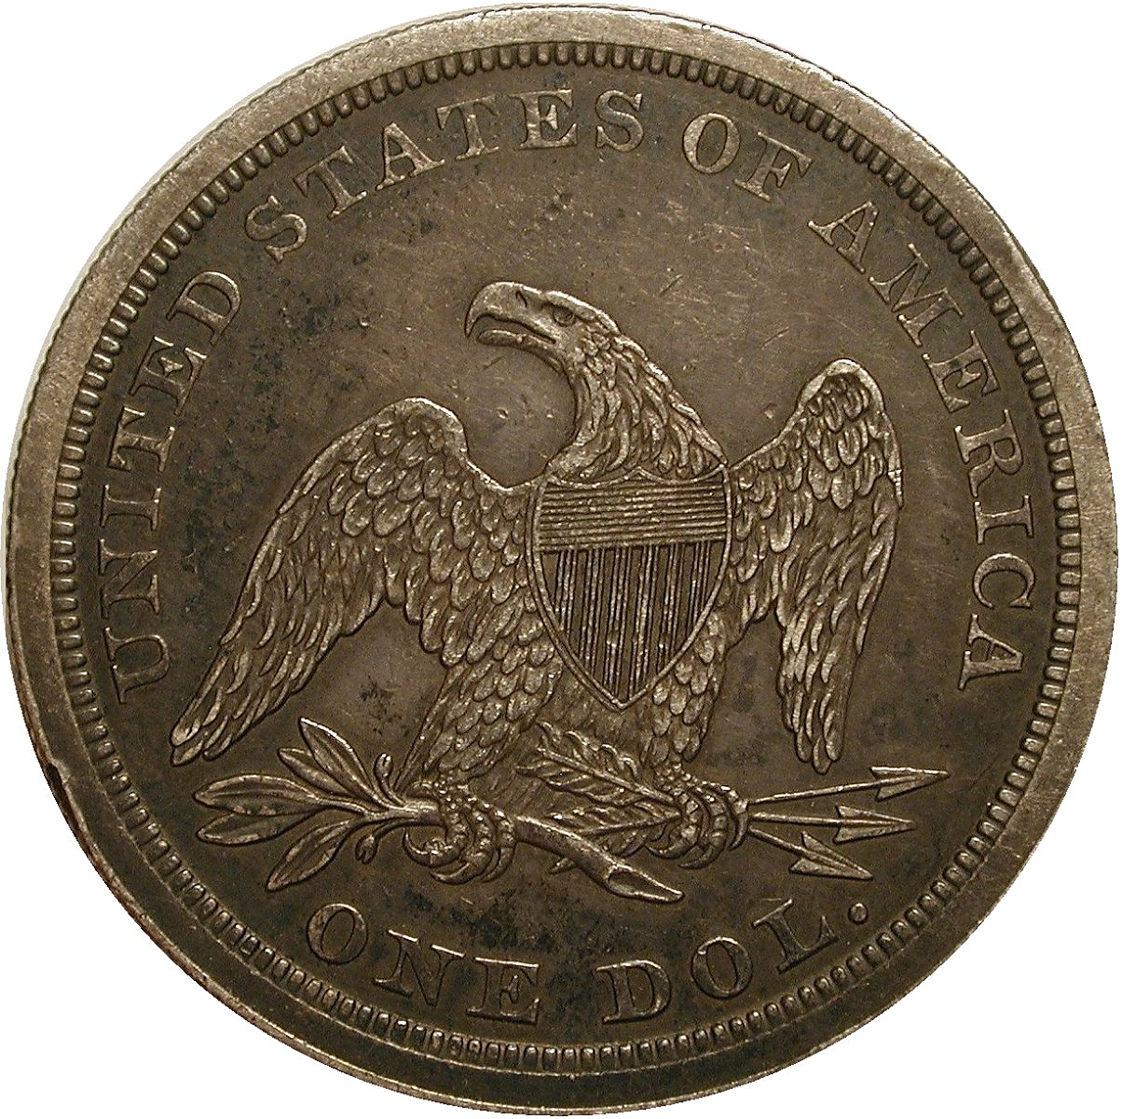
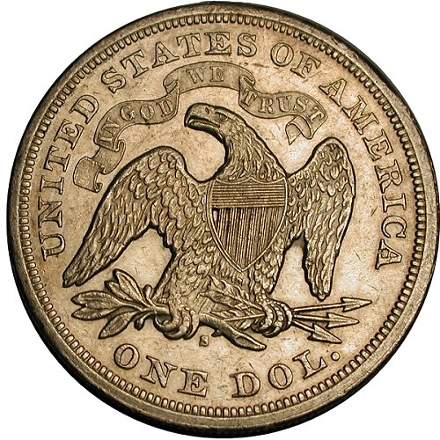
Major Design Sub-types
Arrows at Date (1853-55, 1873-74)
Arrows and Rays (1853)
No Motto (1838-1865)
With Motto (1866-)
Notes:
To signify a reduction in silver weight, Arrows were added to the date in 1853-1855 for half dimes to half dollars. Silver dollars were not affected. This was done again in 1873-1874.
Rays were added to the reverse of quarters and halves for 1853, and they were removed the following year, creating a 1-year type coin.
On quarters, halves, and silver dollars, coins before 1865 have no Motto IN GOF WE TRUST. The Motto was added in 1866 and all subsequent years.

Slide 11
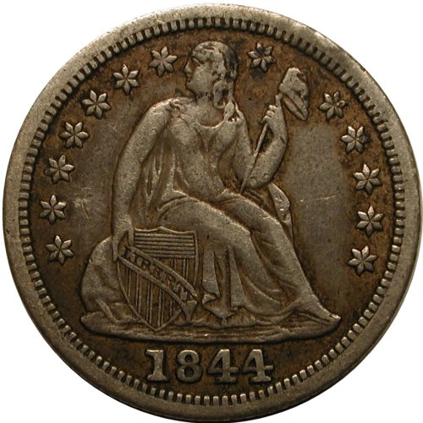

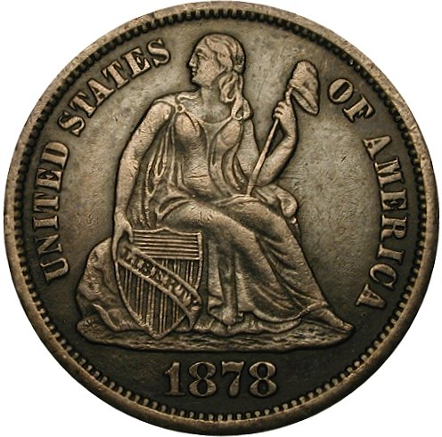
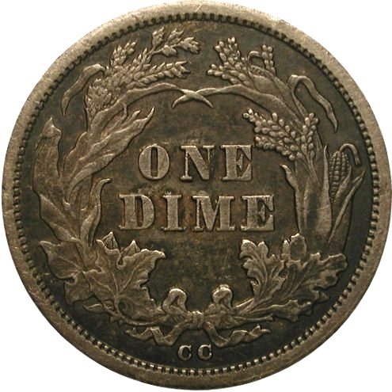
Major Design Sub-types
Stars obverse, Legend reverse (1838-1859)
Legend obverse, Cereal wreath reverse (1860-)
Notes:
For Half dimes and Dimes, 1860 was a transition year with a change in design. For 1859 and earlier, these coins had stars on the obvers and the legend UNITED STATES OF AMERICA was on the reverse.
In 1860, the Legend was moved to the obverse, and the reverse was changed to the “Cereal Wreath” design for all subsequent years.

Slide 12
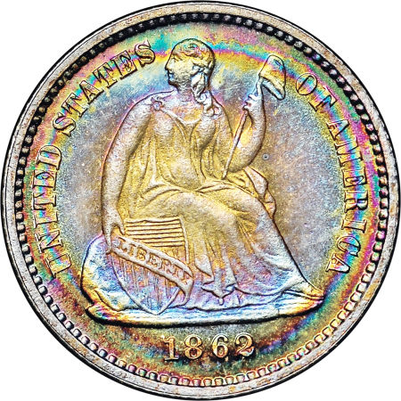
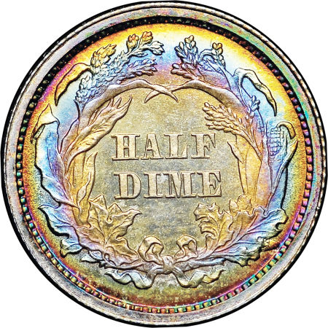
Liberty Seated
Half Dimes
1837-1873

Slide 13
Liberty Seated Half Dimes
Summary
Minted 1837-1873
Designed by Christian Gobrecht
3 mints: P, O, S
5 major subtypes
  No stars (1837, 1838-O)
  Stars, No Drapery (1838-40)
  Stars, Drapery (1840-54, 1856-59)
  Stars, Arrows at Date (1853-55)
  Legend obverse, Cereal wreath (1860-73)
Many varieties
Notes:
Liberty Seated half dimes were minted from 1837-1873, when the denomination was abolished. Designed by Christian Gobrecht, they were struck at 3 mint (Philadelphia, New Orleans, and San Francisco).
5 major sub-types comprise Half Dimes, starting with the No Stars version in 1837.
Many varieties are found in this series, some of them quite interesting, and some of them rare.
NOTE: THIS OVERALL INTRO FOLLOWS WITH EACH SUBSEQUENT DENOMINATION.

Slide 14
Famous Rarity: 1870-S (unique)
Not a regular issue
Unknown prior to 1978
Mint records (discovered in 2004) show at least one struck for new SF Mint cornerstone in 1870
Assumed by many to be a duplicate of the cornerstone coin (similar to unique 1870-S $3 gold)
Nice and attractive AU55+
Later certified (MS61) and upgraded numerous times (now in PCGS MS64 holder!)
Notes:
The rarest and most notable Liberty Seated half dime is the mysterious 1870-S. Unknown to exist prior to 1978, when an example surfaced in Chicago, it is known by a single example.
It has been believed to have been coined along with the other denominations for inclusion in the Cornerstone of the then-new San Francisco Mint. Searches of the mint archives yielded the Receipt from the coiner for the Cornerstone coins, including the 1870-S Liberty Seated dollar and the unique 1870-S $3 gold coin.
The coin is an attractive AU55, and was sold as such twice within a few years after its discovery. With the advent of the Grading Services, the coin has undergone submission and re-submission, starting at MS61, then crossing and upgrading several times over the years. It is now in a PCGS MS64 holder!

Slide 15
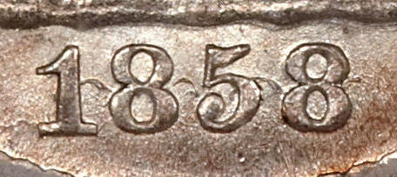
Many, Many, Varieties
About 250 documented varieties (Valentine)
Over 500 recorded varieties (Crain)
Overdates
Misplaced dates
Repunched dates
Doubled dies
Date and Mintmark size variations
Repunched mintmarks
Hub changes
Major die cracks, cuds
Errors
Notes:
Daniel Valentine published the first significant work on Half Dime Varieties, cataloging about 250 of them. Subsequent research by specialist Stephen Crain has recorded over 500 of them, including overdates, misplaced and repunched dates, doubled dies, repunched mintmarks, date and mintmark size variations, etc.
Pictured here is the 1858 Over Inverted Date (date was originally punched upside-down, then corrected), 1849/6, and the 1848 Large Date (accidently used the date punch for the dime, and it goes well into the rock).

Slide 16
Collecting the Series
Collecting
A complete date and mint set (minus 1870-S) consists of 70 coins
A complete sub-type set consists of 5 coins
Difficult dates and stoppers
Expensive dates – 1846, 1853-O No Arrows, 1863-1868 P issues
Major varieties (examples) – 1844-O small-O, 1860 transitional pattern
Stopper: the unique 1870-S, not a regular issue
Notes:
Excluding the 1870-S, which is not a regular issue, the complete set consists of 70 coins. If one wants a sub-type set, this consists of 5 coins.
Key dates include the 1846 (first) and the 1853-O No Arrows (second). The Philadelphia issues from 1863-1868 are also very difficult. Major varieties include the 1844-O small O.
The unusual 1860 Transitional Patterns (Obverse style of 1859 – stars, and the Cereal Wreath reverse of 1860) is very scarce with only 100 struck. This is the famous “Coin without a country” as “UNITED STATES OF AMERICA” does not appear anywhere on the coin.

Slide 17
Typical Costs
One of the “more affordable” sets to complete
Type coins available for a modest cost
$ | G-6 | F12 | VF20 | XF40 | MS63
Common Date | 15 | 25 | 30 | 50 | 300
Complete date/mint set | 5,000 |  | 15,000 |  | 150,000
Notes:
With modest entry prices, the Half Dime is one of the most affordable series to complete (second only to Twenty Cents).
YOU CAN POINT OUT SEVERAL PLACES IN THIS CHART, INCLUDING A COMMON DATE USED AS A TYPE COIN, AND THE COST OF COMPLETE SET IN VARIOUS GRADES.

Slide 18
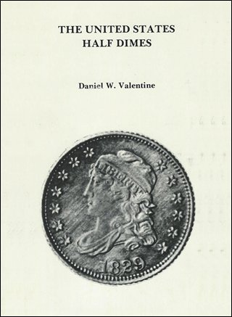
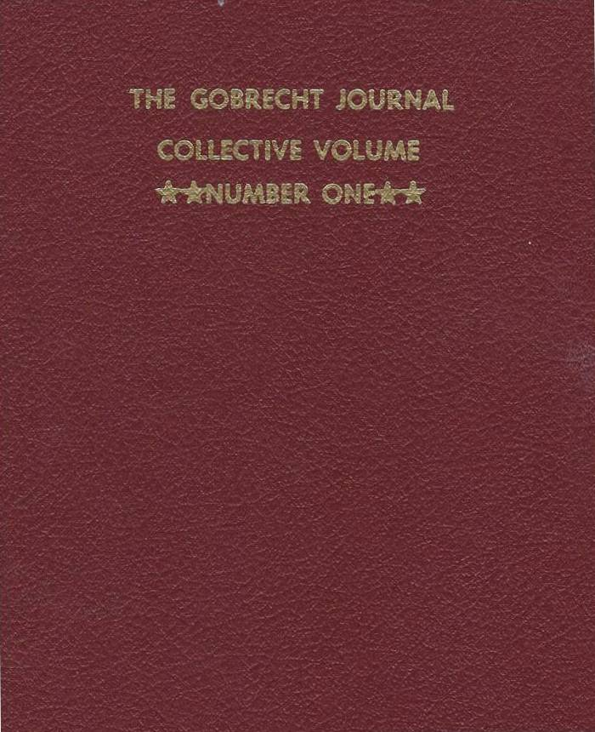
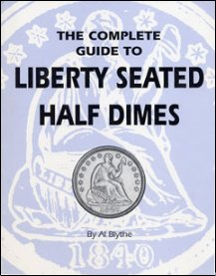
References
Notes:
Good references include numerous articles in the Gobrecht Journals and the various Collective Volumes of the Gobrecht Journal.
Daniel Valentines original book on US Half Dimes was followed by Al Blythe’s “Complete Guide” book published in the 1990s.

Slide 19
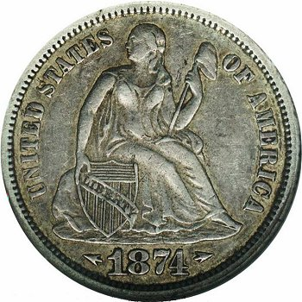
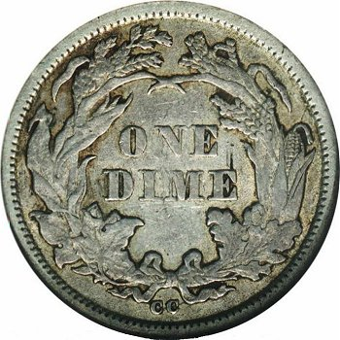
Liberty Seated Dimes
1837-1891

Slide 20
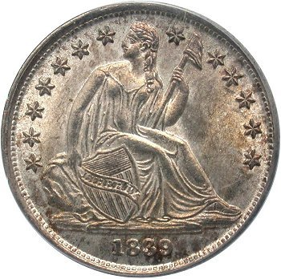
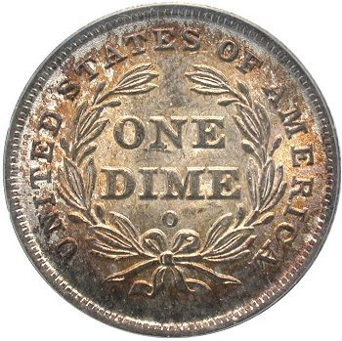
Liberty Seated Dimes
Minted from 1837 to 1891
  Proof strikes 1837 through 1891
Mints: P, O, S, CC
6 major subtypes
  No stars on obverse (1837, 1838-O)
  Obverse stars, no drapery (1838-1840)
  Obverse stars, drapery (1840-53, 1856-59)
  Obverse stars, arrows at date (1853-55)
  Legend on obverse (1860-73, 1875-91)
  Legend obverse, arrows at date (1873-74)
A very challenging set to collect
Notes:
Liberty Seated dimes were minted from 1837-1891, when the Barber design took over in 1892. Designed by Christian Gobrecht, they were struck at 4 mints (Philadelphia, New Orleans, Carson City, and San Francisco).
6 major sub-types comprise Half Dimes, starting with the No Stars version in 1837.
With many very difficult dates, this is a very challenging series to collect.

Slide 21
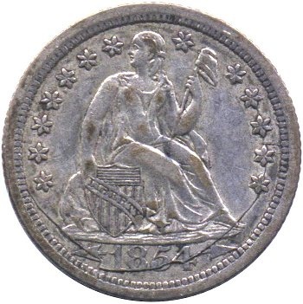
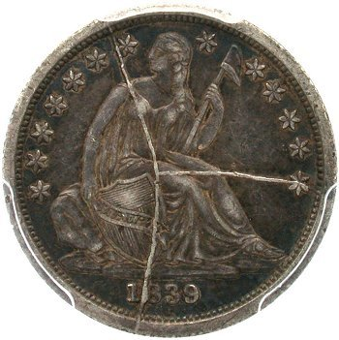
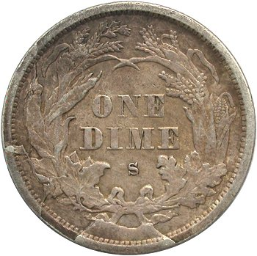
Substantial number of varieties
Greater than 1400 documented varieties (SeatedDimeVarieties.com)
Top 100 Varieties set – NGC recognized
Important shattered dies and terminal die states
Date and mintmark size variations
Misplaced dates
Repunched dates and mintmarks
Doubled dies
Rotated reverse dies
Hub changes
Notes:
In Gerry Fortin’s online reference, more than 1400 varieties have been documented. In addition, NGC recognizes a “Top 100 Varieties” set.
Some of the more interesting varieties include a number of shattered dies and terminal die states, with fantastic die breaks and cuds. Pictured here are a few examples, including the 1839 Pie Shaped Shattered obverse.

Slide 22
Collecting the Series
Collecting
Base business strike set contains 114 coins
Adding Redbook varieties leads to 121 coins
A complete sub-type set consists of 6 coins
Difficult dates and stoppers
Key dates: 1871-CC, 1872-CC, 1873-CC, 1874-CC, 1885-S
Challenging dates: 1846, 1856-S, 1859-S, 1860-O, 1863-1867-P, 1870-S
Stopper: 1873-CC No Arrows (unique)
Notes:
Collecting a complete set requires 114 coins. Adding the key Red Book varieties brings the total to 121 coins. A type collector would need 6 coins for a compete sub-type set.
The key dates of the series include the early Carson City issues from 1871 to 1874, and also the 1885-S.
Numerous other challenging dates include low-mintage and low-survival dates, including 1846, 1856-S, 1859-S, 1870-S, and the Philadelphia issues from 1863-1867. The 1860-O is difficult to find in all grades, and very difficult to find with nice surfaces.
The unique 1873-CC No Arrows is the stopper.

Slide 23
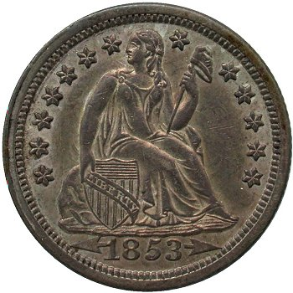
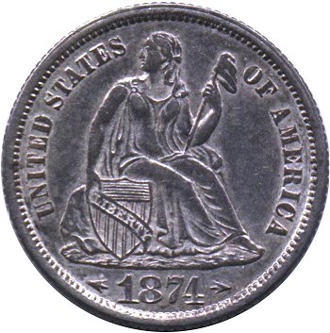
Typical costs
$ | G-4 | F12 | VF20 | XF40 | MS63
Common Date | 16 | 25 | 35 | 45 | 300
Complete date/mint set | 24,000 | 50,000 | 67,000 | 130,000 | -
Notes:
With some many tough dates, this is a difficult and expensive series to complete, although nice type coins are affordable.
YOU CAN POINT OUT SEVERAL PLACES IN THIS CHART, INCLUDING A COMMON DATE USED AS A TYPE COIN, AND THE COST OF COMPLETE SET IN VARIOUS GRADES.

Slide 24
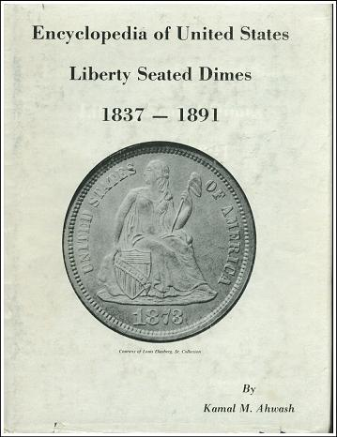
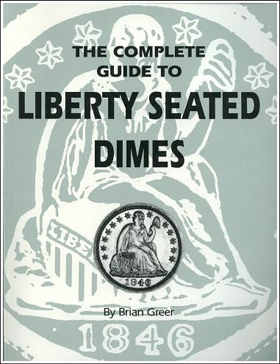
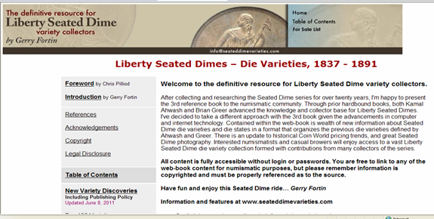
Dime References
The Definitive Resource for Liberty Seated Dime Variety Collectors
Gerry Fortin, 2004-2015 http://www.seateddimevarieties.com
Encyclopedia of United States Liberty Seated Dimes, 1837-1891
Kamal M. Ahwash, 1977
The Complete Guide to Liberty Seated Dimes
Brian Greer, 1992
Notes:
Kam Ahwash, one of the founders of the Liberty Seated Collectors Club, published the first comprehensive references on Liberty Seated Dimes. Brian Greer updated and expanded the literature with his “Complete Guide” in the 1990s. The most comprehensive reference is the web book by Gerry Fortin, SeatedDimeVarieties.com.

Slide 25
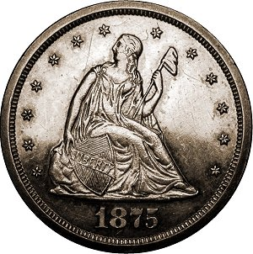
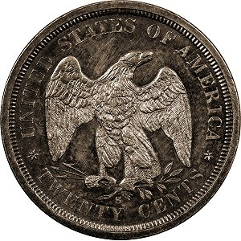
Double Dimes – Twenty-cent Pieces
1875-1878

Slide 26
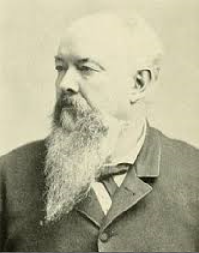
Why the Double Dime?
The excuse
Nevada Senator John Percival Jones: short-changing rampant out west without the silver half dime
  Buy 10¢ item, pay with a quarter, get a dime for change, losing 5 cents in the transaction
The real reason
Wanted a new reason for the U.S. Mint to purchase silver from the western mines
Senator Jones had mine-owner friends, and had mining interests of his own
Notes:
The short-lived Twenty-cent series began under unusual circumstances, and in this case, the real reason was different than the excuse used to justify the new denomination. Both the excuse and the reason involve this man, the junior senator from Nevada, John Percival Jones.
The excuse given was…. With the demise of the Half Dime in 1873, the western states had a shortage of small change, and this led to a wide-spread short-changing problem. If somebody bought an item for 10 cents and paid with a quarter, he or she often only got 10 cents in change (no half dimes), thus being short-changed. A 20-cent coin would obviously solve this problem. Of course, so would coining more dimes!
The real reason is that the silver lobby wanted the US Mint to purchase more silver bullion from the western mine owners, not less. With the demise of the half dime, trime (silver 3 cents), and silver dollar, the only logical way to accomplish this would be to create a new denomination.
Senator Jones not only had campaign contributors who were silver mine owners, he had silver interests of his own. This is the real reason the coin was created.

Slide 27
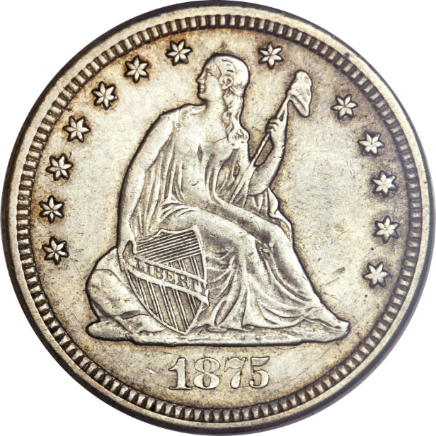
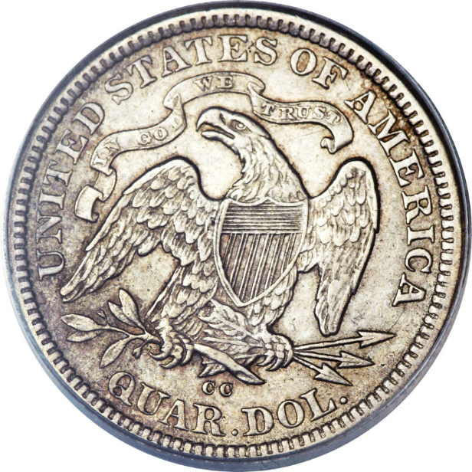
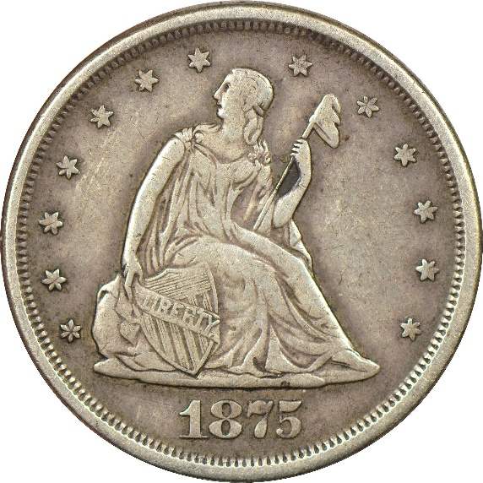
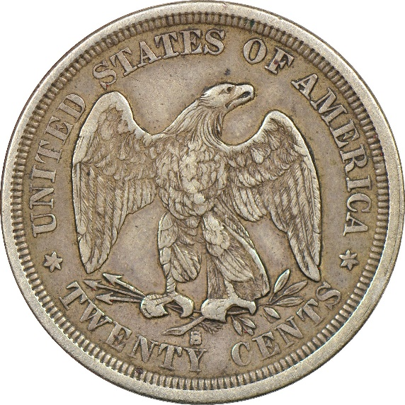
Double dimes 1875-1878
Minted for circulation for only 2 years
Plus 2 more years as proof-only issue
Biggest flop in U.S coinage history…
You can judge why…
Quarter 20-cent Piece
Notes:
The Double Dime as it was called, was coined for circulation for a little less than a year, spanning 1875 and 1876. Simply put, it was the biggest flop in the history of US coinage.
There is nothing strange about the 20-cents denomination itself, but putting this new coin alongside the 25-cent quarter, it is obvious why confusion and public rejection was inevitable.
STEP THROUGH THE 4 STEPS OF ANIMATION –
“Quarter….. 20-cent piece. Quarter….. 20-cent piece”

Slide 28
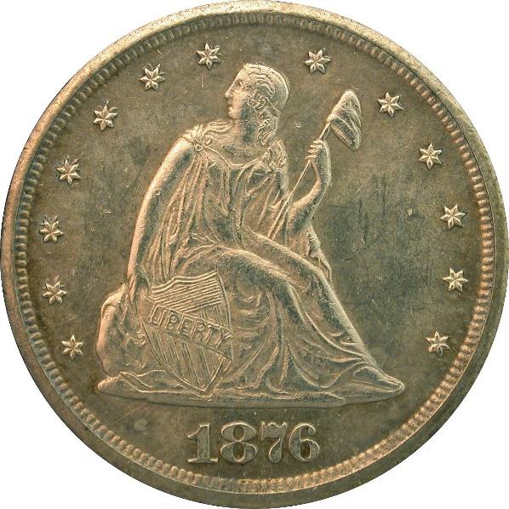
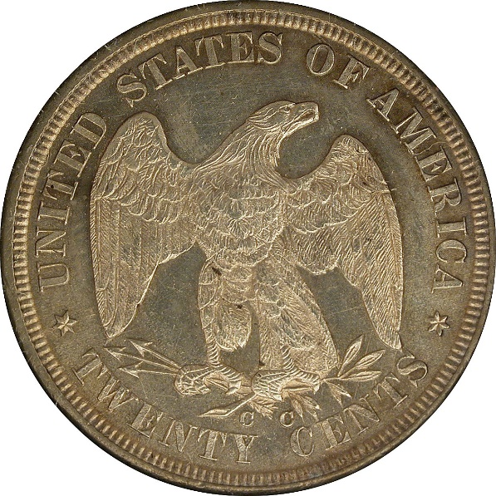
Collecting the Series
Collecting
Often collected as a type coin
Base circulation strike set contains 4 coins
Adding proof-only issues makes it 6 coins
Very reasonable set to complete
Die marriage set also very manageable
1876-CC is a legendary rarity, and not a regular issue
Dates and stoppers
Common dates: 1875-S, 1875-CC
Challenging dates: 1875-P, 1876-P
Expensive dates: 1877, 1878 (proofs only)
Stopper: 1876-CC (fewer than 20 known)
Notes:
More than 95% of collectors think of the 20-cent piece as a type coin, only trying to obtain a single example for their Type Set.
Collecting the entire set of regular issue business strikes requires 4 coins. Adding the two proof-only issues makes the complete set 6 coins.
Thus, this is the easiest Liberty Seated series to complete.
This short series does include one of the legendary rarities in all of U.S. coins… the 1876-CC. With almost the entire mintage of 10,000 melted at the mint before issuance, there are fewer 20 examples known today, purchased at the mint as souvenirs, perhaps under the belief that the 20-cent piece would not last.
The two common dates are the 1875-S (mintage over 1 million) and the 1875-CC (133 thousand). Even though common, the 1875-CC is costly due to the high interest in CC coins.
The two scarce business strikes are the Philadelphia issues. Low-mintage 1875 and lower-mintage 1876 are the hardest to find, and actually cost less than 1875-CC.
The proof-only 1877 and 1878 are the most expensive and difficult to find. Interestingly, there is huge demand for circulated examples of the proof-only issues.
The stopper of the set is the 1876-CC, where even the few circulated and impaired examples will cost six figures.

Slide 29




Varieties
Many for a short series
6 misplaced dates
4 repunched mintmarks
2 doubled dies
28 die marriages
  27 excluding 1876-CC
Major die cracks, cud
Notes:
For such a short-lived series, there are lots of interesting varieties, including misplaced dates (6 of them), repunched mintmarks (4) and also two doubled dies.
A number of the reverse dies can be found with spectacular die cracks and breaks.
For variety and die-marriage collectors, this series is very doable, as only 27 die marriages are known (excluding the 1876-CC).

Slide 30






Errors and Exonumia
Due to short lifespan of series, errors are rare
Exonumia (love tokens, elongates, jewelry) hard to find
Notes:
Errors are scarce to rare on Liberty Seated coinage in general, but especially so for the 20-cent piece, due to the short time span the coins were made.
In addition, while some types of exonumia (such as love tokens, etc.) are commonly found on Seated Dimes, they are much more difficult to find on 20-cent pieces for the same reason – short lifetime of the series.

Slide 31
Typical costs
$ | G-4 | F12 | VF20 | XF40 | MS63
Common Date (1875-S) | 85 | 125 | 150 | 250 | 1,200
All 4 circulation strikes | 975 | 1,500 | 1,850 | 2,100 | 8,500
Complete date/mint set | - | 7,650 | 8,150 | 9,100 | 17,500
Complete with 1876-CC | - | - | - | 110,000 | 350,000
Impossible to find proof-only issues in G, nearly so in F or VF
Circulated 1876-CC coins are of highest rarity
Notes:
The costs of building a circulated set of the business strikes is quite affordable. Adding Proof-only coins will add significantly to the cost. Circulated examples of the proof-only coins will lower the cost only slightly, as high demand for the very few of them keeps prices high.
It should be noted that acquiring low-grade examples of the Proofs is impossible, as it is doubtful any exist below Fine-VF, and only one or two at that level (THIS HIGHLIGHTED IN RED FONT). Most circulated examples are in XF and AU.
If you add the 1876-CC, this will increase by leaps and bounds. Also, the number of circulated examples is about 4, with most of them XF-AU. There is only one known low-grade example. Most are MS63-MS64.

Slide 32

References
New book www.doubledimes.com
Notes:
The only comprehensive reference is the new book by Lane Brunner and John Frost, published 2014. The entire contents of the book can also be found as a web book, at no cost, at doubledimes.com.

Slide 33


Liberty Seated Quarters
1838-1891

Slide 34


Liberty Seated Quarters
Generally considered the most difficult Liberty Seated series to complete
Numerous dates are unknown in mint state, and nearly so in high circulated grades
4 mints: (P, O, S, CC)
Six major sub-types:
  No drapery below elbow (1838-39, 1840-O)
  With drapery (1840-53, 1856-65)
  Arrows at date, rays on reverse (1853 only)
  Arrows at date, no rays (1854-55)
  With Motto on reverse (1866-73, 1875-91)
  With Motto, arrows at date (1873-74)
Many very difficult dates
Notes:
Liberty Seated quarters are generally considered to be the most difficult of all the series to be completed, especially in high grades.
In higher grades, a number of issues are completely unknown in Mint State, and nearly so in AU and even XF.
Minted at 4 mints, the series has six major sub-types,
In addition to the high-grade rarities, there are many dates that are very difficult to find in any grade whatsoever.

Slide 35






Many, many varieties
About 300 major varieties
Overdates
Misplaced dates
Repunched dates
Doubled dies
Date and mintmark size variations
Repunched mintmarks
Major die cracks, cuds
Hub changes
Errors
Notes:
About 300 major varieties are known, including overdates, misplaced and repunched dates, doubled dies, repunched mintmarks. There are also variations in date and mintmark sizes.
Some of the more popular varieties pictured include:
- 1854-O Huge O quarter (the die was absent the mintmark when it arrived in New Orleans, and the coiner hand-carved the mintmark, leaving the large, bold, mutant-looking mintmark). A popular and scarce, but not rare, variety.
- 1873 Closed 3, No Arrows
- 1853/4, made late 1853 when some dies for 1854 were already being made, and the date 1853 was repunched over the 1854.
- 1857 Smoking Liberty (lower right) where a die line/break looks like a cigarette in Liberty’s hand.

Slide 36


Collecting the series
Collecting
A complete date/mint set consists of 108 coins
A complete sub-type set consists of 6 coins
Difficult dates and stoppers
Major varieties (examples): 1840-O Large O, 1853 No Arrows, 1854-O Huge O, 1856-S/s, 1873 Close 3
Expensive dates: 1849-O, 1864-S, 1872-S, 1870-1873-CC, 1891-O
Big stopper: 1873-CC No Arrows (5 known)
Notes:
A complete set consists of 108 different coins, and a type collector must acquire 6 coins for a sub-type set of Liberty Seated quarters.
Difficult varieties include: 1840-O Large O, 1853 No Arrows, 1854-O Huge O, 1856-S Large S over Small s, and the 1873 Close (aka Closed) 3.
Key Dates (thus expensive) include 1849-O, 1864-S, 1872-S, the early Carson City issues from 1870-1873, and the final New Orleans issue, 1891-O.
With only 5 known, the non-collectible 1873-CC No Arrows is the big stopper of the set.

Slide 37
Typical costs
$ | G-4 | F12 | VF20 | XF40 | MS63
Common Date | 24 | 35 | 45 | 65 | 550
Complete year-only set | 8,000 |  | 20,000 | 40,000 | -
Complete date/mint set | 48,000 |  | 140,000 | 300,000 | -
Notes:
This is the most difficult and expensive series to complete, although nice type coins are affordable.
YOU CAN POINT OUT SEVERAL PLACES IN THIS CHART, INCLUDING A COMMON DATE USED AS A TYPE COIN, AND THE COST OF COMPLETE SET IN VARIOUS GRADES.

Slide 38




References
Quarter of the Month
Notes:
In addition to the Gobrecht Journal (including Collective Volumes), the main reference is Larry Briggs’ Comprehensive Encyclopedia on the series, written in the 1990s. Auction Catalogs, such as the Eliasburg sale, provide excellent reference material.

Slide 39


Liberty Seated Halves
1839-1891

Slide 40
Liberty Seated Halves
Minted 1838-1891
4 mints: P, O, S, CC
Minted under 3 governments: USA, State of LA, CSA
Eight major sub-types:
  No drapery below elbow, small letters reverse (1839)
  With drapery, small letters reverse (1840-42)
  With drapery, medium letters (Bust) reverse (1840-O no O only)
  Large letters reverse, no Motto (1842-52, 1856-65)
  Arrows at date, rays on reverse (1853 only)
  Arrows at date, no rays (1854-55)
  With Motto on reverse (1866-73, 1875-91)
  With Motto, arrows at date (1873-74)
Many varieties
Notes:
Minted from 1838-1891, Liberty Seated Halves were minted from 4 mints. In addition, this is the only series that was actually minted under the authority of 3 different governments (the 1861-O was minted under the Federal – USA – government, then the State of Louisiana following secession, and then the CSA, before the New Orleans Mint was closed).
The Liberty Seated Half had more design sub-types than the other series, with 8 different design types. Different size of reverse lettering resulted in an additional subtype over the other series. Perhaps the most interesting, and unique, sub-type was the initial New Orleans issue of 1840. Still waiting for reverse dies with an O mintmark, the mint began coining 1840 halves, and used the reverse left over from the Bust/Reeded Edge halves. Because on the Bust issues, the mintmark was on the obverse, these initial New Orleans coins did not have an O mintmark, and is distinguished by the Medium Letters and Eagle size.
As can be imagined, there were also many varieties.

Slide 41







Many, many varieties
About 300 major varieties
About 1,800 die marriages
Overdates
Misplaced dates
Repunched dates
Doubled dies
Date and MM size variations
Repunched mintmarks
Major die cracks, cuds
Hub changes
Errors
Notes:
About 300 major varieties are known. Due to extensive study, about 1800 distinct die marriages have been cataloged. Some of the varieties are interesting, and others spectacular.
Some of the more popular varieties shown where include
1844-O doubled date (first date placement was well into the rock)
The rare 1873 No Arrows, Open 3
1876 Large Date over Small Date
1847/6

Slide 42

Collecting the series
Collecting
A complete date/mint set consists of 112 coins
A complete sub-type set consists of 8 coins
Difficult dates and stoppers
Major varieties (examples): 1847/6, 1873 NA Open 3, 1875-S Micro S, 1876 Large/Small date
Expensive dates: 1851, 1852, 1870-CC to 1874-CC, 1878-CC
Stopper: 1878-S (~60 known)
Big stopper: 1853-O No Arrows (4 known)
Notes:
The complete set consists of 112 coins. A type collector would need 8 coins to have each design sub-type.
The difficult varieties include 1847/6 1873 No Arrows Open 3 (made for only a short time with Open 3 before arrows were added), 1875-S Micro S, and the 1876/1876 Large over Small date.
Scarce and expensive dates include the Philadelphia issues of 1851 and 1852 (due to much melting prior to silver weight reduction in 1853), and early Carson City issues of 1870-1874, and the 1878-CC.
The Key to the regular set is the rare 1878-S, with only about 60 known
The non-collectible 1853-O No Arrows has only 4 known examples.

Slide 43


Typical costs
$ | G-6 | F12 | VF20 | XF40 | MS63
Common Date | 45 | 70 | 90 | 175 | 1,325
Complete year-only set | 7,500 |  | 13,000 | 19,000 | 94,000
Complete date/mint set, minus 1853-O No Arrows | 65,000 |  | 115,000 | - | -
Complete date/mint set, with 1853-O No Arrows | 300,000 |  | 915,000** | - | -
** 1853-O No Arrows in VF35
Notes:
With some many tough dates, this is a difficult and expensive series to complete, although nice type coins are affordable. The 1853-O No Arrows is considered non-collectible, and warrants a separate listing. The bulk of the cost on the Complete Date/Mint set is in just a few issues, notably 1878-O, 1870-CC, 1874-CC, 1878-CC.
YOU CAN POINT OUT SEVERAL PLACES IN THIS CHART, INCLUDING A COMMON DATE USED AS A TYPE COIN, AND THE COST OF COMPLETE SET IN VARIOUS GRADES.

Slide 44







References
Notes:
In addition to the Gobrecht Journals and the Collective Volumes, the single best reference is the Complete Guide written in the 1990s, known as the WB (Wiley-Bugert) book. It is out of print in high-demand, but it is available online as well.
A detailed reference on all known die marriages includes the series by Bill Bugert, Register of Liberty Seated Die Varieties. 4 books presently include the San Francisco Mint, Carson City Mint, New Orleans 1840-O to 1853-O No Arrows, and New Orleans 1853-O Arrows to 1861-O.
The series of books on the Philadelphia issues are in development.

Slide 45

Liberty Seated Dollars
1840-1873

Slide 46
Liberty Seated Dollars
Minted 1840-1873
4 mints: P, O, S, CC
Two major sub-types:
  No Motto (1840-1865)
  With Motto (1866-73)
Total mintage of the entire series just over 6 million
Many very low mintage coins
Very difficult series to complete, both due to high cost of common coins, and the big challenge to find the better and rare dates
Notes:
Liberty Seated dollars were minted for 34 years, 1840-1873. Coined at 4 mints, there are only two sub-types: No Motto and With Motto.
This very difficult series, the entire mintage consisted of just over 6 million pieces. With many very low mintage coins, this is a difficult series to complete. Not just the key dates, but many, many, semi-keys as well. There are only a handful of truly common dates.
The cost of entry is high, and even the most common issues are costly. And even if money is no problem, finding many of the coins will take some diligent searching.

Slide 47


Legendary rarity – 1870-S
No record of mintage
A few coins started showing up in circulation in the 1870s and 1880s
Hand-engraved mintmark on die
Later discovered to have been minted special for inclusion in the Cornerstone of the new SF Mint (along with 1870-S half dime and gold $3)
11-12 known, not a regular issue
Notes:
The Liberty Seated Dollar includes the legendary 1870-S, which is actually rarer than the famed 1804 dollar.
There is no record of how many were made. Like the 1870-S Half Dime, the only documentation on the coin is the original coinage receipt for the coins placed in the Cornerstone of the San Francisco Mint, nicknames the Granite Lady. Clearly duplicates were made and placed into circulation, but nobody knows how many.
With no record, a few coins started showing up in circulation in the 1870s. The coin has a hand-engraved mintmark. Apparently like the 1870-S $3 gold coin (also unique), the reverse die made it to San Francisco without a mintmark, and one had to be engraved by hand.
Depending on who you talk to, there are between 9 and 12 known. Only one example has any claim to Mint State. Most examples are XF and AU.

Slide 48
Plenty to Collect
45 dates/ mintmarks
About 50 varieties, mostly minor, but some very interesting
  Repunched dates
  Doubled dies
  Misplaced dates
  200+ die marriages (including proofs)
Moderate cuds and die cracks
Notes:
There are 45 dates and mints in the complete set. About 50 varieties are known, most of the minor. A few, however, are quite interesting.
There are a number of repunched dates, misplaced dates, and doubled dies.
Detailed study of the series has cataloged more than 200 die marriages. Some of the dies exhibit die cracks and some cuds.

Slide 49

Varieties
Major Varieties (samples)
1842 MPD
1844 DDO and MPD
1856/6
1867/1867 large/small date
1869 MPD, 1871 MPD, 1872 MPD
1872 and 1873 DDR
Interesting die states – 1842 with 3 obverse rim cuds (also 1 and 2 cuds)
Notes:
There are some notable varieties, including the 1844, which has both a doubled obverse die and a misplaced date (pictured).
Other varieties include 1856/6, 1867/1867 Large date over small date.
Misplaced dates can be found on some 169, 1871, and 1872 coins. Some 1872 and 1873 come with doubled reverse dies.
One very interesting die state includes an 1842 that is known with up to three distinct rim cuds on the obverse.

Slide 50


Difficult Dates and Stoppers
Expensive dates:
  Most
Stoppers:
1851 (about 50 known)
1852 (about 50 known)
1858
Most CCs
The BIG Stoppers:
1870-S (11-12 known)
1866 No Motto (Fantasy coin, 2 known)
Notes:
For expensive coins, this is most of the series. As mentioned before, the cost of entry is high, and any Seated Dollar that is without holes, large cuts or scratches, will likely be worth at least a couple hundred dollars.
There are only a few truly common coins, and many semi-keys will cost more.
The true key dates, and most expensive, include the very low mintage 1851 and 1852, with about 50 known of each. The proof-only 1858 is expensive, but generally available. The Carson City issues of 1871 to 1873 are very scarce to rare, and are also quite costly. The 1870-CC is the only modestly price coin from that legendary mint.
The big stopper is the non-collectible 1870, where even the worst known example (highly-damaged and tooled piece) is a six-figure item.
The clandestinely-made fantasy 1866 No Motto items (2 known) are also big-ticket items, although they are not technically coins or patterns.

Slide 51
Typical Costs
$ | G-6 | F12 | VF20 | XF40 | MS63
Common date | 300 | 350 | 425 | 650 | 4,500
Type set | 600 | 700 | 850 | 1,300 | 9,000
Complete date-only set | 90,000 |  | 150,000 | 275,000
Complete date/mintmark set, minus 1870-S | 150,000 |  | 300,000 | 450,000
Complete date/mintmark set, with 1870-S | 350,000 |  | 750,000 | 1,250,000
Difficult to find nice low-grade coins of most dates
Impossible to assemble complete sets in these low grades
Notes:
Building a type set will require only two coins (No Motto, With Motto).
** Orange font means that finding low-grade problem-free Seated Dollars is challenging but possible. Red font means that despite values in low grades being listed in price guides, it would be impossible to build a complete date or date/mintmark set in low grades, as a number of the coins are simply unknown in these low grades (like the 1851 and 1852).

Slide 52



References
SeatedDollarVarieties.com
Notes:
The best reference today is the Q. David Bowers reference Silver Dollars of the United States. The Walter Breen Encyclopedia is an excellent reference.
A web-based reference on all known varieties and die marriages is under development and available at SeatedDollarVarieties.com. A printed book is planned for the second half of 2016.

Slide 53


Trade Dollars
1873-1885

Slide 54
Intention and politics
Intended for international trade, specifically to far east
Competitive with Mexican, Spanish, and other coins
Not intended for domestic use
Sold domestically for the bullion value (not face value)
Abused by large business owners:
  Bought by business for bullion (~85-88 cents)
  Given to employees in pay envelopes at face value
  Accepted at company stores at bullion values
  Employees got short-changed
Big success overseas – served their purpose
Domestically became our most hated coin
Notes:
The Trade Dollar, introduced in 1873, was not intended for domestic commerce. It was in response to Liberty Seated Dollars being exported for bullion trade use in the Orient. To be more competitive with the coins of other countries (Mexico, Spain, etc.), the Trade Dollar has a heavier weight than the standard silver dollar. In the United States, the coin was sold based on bullion value, not a dollar of face value. During most of its tenure, the coins were worth below 90 cents for their silver value.
Although not intended for domestic use, the Legal Tender status was not clarified, and this fact led to widespread abuse. For large business owners, particularly where “company towns” sprung up, many employers bought the Trade Dollars for their bullion value (example, 85-88 cents), and then actually paid their employees in Trade Dollars, at face value of $1. When these same employees wanted to buy goods in Company Stores, they would only be accepted for their bullion value! Therefore, while the coin saw success overseas as a bullion coin, domestically it quickly became America’s most hated coin.

Slide 55
Trade Dollars
Designed by William Barber
Minted 1873-1885
3 mints: P, S, CC
Two major sub-types for both obverse and reverse:
  Obverse Type I (1873-1876)
  Obverse Type II (1876-1885)
  Reverse Type I (1873-1876)
  Reverse Type II (1875-1885)
Many combinations of the different types in 1875-76
Proof-only regular issues 1878-1883
10 pieces made clandestinely in 1884, not a regular issue
5 pieces dated 1885, also made clandestinely
Notes:
Unlike the other Liberty Seated series, this coin was designed by William Barber, Chief Engraver of the Mint from 1869-1879. Barber also designed the 20-cent piece and used the Eagle motif of the Trade Dollar two years later on the Double Dime.
Minted at 3 different mints, the Trade Dollar underwent minor design changes for both the obverse and reverse dies. As a result, there is a Type I and Type II for both obverse and reverse. However, the transitions occurred at different times, and some Type I reverses can be found as late as 1876, even after the Type II was introduced in 1875. Therefore, that are numerous combinations of the Type I and Type II dies to be found, as seen in this list:
Obverse Type I can be found 1873-1876
Obverse Type II was introduced in 1876, and was used thereafter
Reverse Type I is on all 1873 and 1874 coins, and some 1875 and 1876
Reverse Type II is on some 1875 and 1876 coins, and all 1877 and later.
Most Trade Dollars were made in San Francisco and Carson City for export. Fewer made in Philadelphia, and beginning 1878, only proofs were made in Philadelphia thereafter until 1883.
In 1884, dies may have prepared for continuing Proof coinage (as in 1883) but this is not confirmed, Regardless, the decision was made to stop production. However, 10 Proofs were struck clandestinely, without any apparent authorization, purely for profit. In 1885, somebody at the mint clandestinely fashioned dies and again struck 5 proofs. Technically not coins, these 1884 and 1885 numismatic items are still highly prized, like the 1913 Liberty Nickels, which were struck 32 years later under similar circumstances.

Slide 56








Trade Dollar Sub-types
Type I
Type I
Type II
Type II
Notes:
The hub changes in both obverse and reverse dies were minor, but the differences between Type I and Type II dies are easy to identify.
Obverses:
- Type I has ribbon end short and stubby, and bent to the left.
Liberty’s hand only has 3 fingers below the stem
- Type II has longer ribbon ends, and they hang straighter
Liberty’s hand has 4 fingers visible below the stem
Reverses:
- Type I features a berry in the gap between the Eagle’s claw
Arrow’s point is between 2 and 0 in “420”
- Type II omits the berry, and there is clear space within the claw
Arrow’s point is over the center of the 2 in “420”

Slide 57


Chop marks
Chop marks often applied to Trade dollars by merchants
  To certify acceptance for silver weight and fineness
  Often Chinese characters
  Sometimes one, sometimes many chop marks
Chop marks are considered damage, but highly collected
All circulation issues known to exist with chop marks
  1878-CC and 1875-P are rarest
Notes:
Many Trade Dollars that saw commercial use in the Orient can be found with counterstamps, called chop marks. Chop marks are often featuring Chinese characters, often representing a word or even a business name. Some coins have a single chop mark, and others have several to many.
Chop marks were imparted by people or businesses that accepted the coin, to certify that the individual/business had deemed the coin was of proper weight and fineness. Once a coin had several chops, subsequent takers of the coin did not necessarily feel the need to add additional chops. However, a few pieces can be found with many dozens of chops, almost mutilating the coin.
While chop marks are considered damage, it is not considered the same type of damage that other coins suffer from time to time. Chop marks are accepted by many collectors as they were the normal result of the type of commerce intended for these coins. They are widely collected. For many years, the price discount for chop marked coins was huge, but in recent years, this discount has been drastically reduced.
All business strike issues are known with chop marks, but the rarest dates with chop marks are 1878-CC (first) and 1875-P (second).

Slide 58

Varieties
Over Mintmarks
Misplaced dates
Repunched dates
Doubled dies
Date and Mintmark size variations
Repunched mintmarks
Multiple Hub Combinations
Errors
Notes:
A number of varieties are known in addition to the Type I/Type II hub changes. Numerous doubled dies, misplaced and repunched dates, and over mintmarks are known.
Two widely popular varieties include the 1875-S/CC over mintmark, and the 1876-CC doubled die reverse.

Slide 59

Collecting Trade Dollars
Collecting
A circulation strike date/mint set consists of 17 coins
A complete date/mint set consists of 23 coins
A sub-type set requires 3 coins (Types I/I, I/II, II/II)
Expensive dates:
  Key date 1878-CC
  Most other CC coins
  1875-P
  Proof-only 1878-1883 coins
The BIG Stoppers:
1884 (10 known, clandestine issue, not a coin)
1885 (5 known, clandestine issue, not a coin)
Notes:
Collecting a full date and mintmark set requires 23 coins. Just a date set represents 17 coins.
Type collectors require 3 sub-types
Type I obverse, Type I reverse
Type I obverse, Type II reverse
Type II obverse, Type II reverse
The key date is the 1878-CC, the rarest regular issue
1875-P is the second scarcest coin in the set, and is pricey
Most of the other Carson City coins are expensive
The Proof-only issues of 1878-1883 will cost almost $1000, even if circulated
The two big stoppers are the two non-regular issues, the 1884 (10 known) and the 1885 (5 known), both clandestine issues.

Slide 60
Typical Costs
$ | G-6 | F12 | VF20 | XF40 | MS63
Common date (S mint) | 100 | 175 | 200 | 250 | 2,000
Sub-type set | 300 | 525 | 600 | 800 | 6,500
Complete date-only set | 650 |  | 1,200 | 1,800 | 12,000
Complete date-only set with proof-only issues | 6,000 |  | 10,200 | 12,000 | 33,000
Complete date/mintmark set of circulation strikes | 3,200 |  | 7,600 | 12,500 | -
Complete date/mintmark set with proof-only issues | 8,600 |  | 17,000 | 22,000 | -
Difficult but possible to find nice low grade coins
Impossible to find proof-only issues in these low grades
Notes:
As with Seated Dollars, finding low-grade problem-free Trade Dollars can be a challenge. While an occasional Good or VG can be found, building a complete set would be very difficult. The Proof-only coins are virtually unknown in low grades, but can be found in XF and above.

Slide 61

References
Notes:
The same references exist as in the Seated Dollars, primarily Bower’s reference on Silver Dollars of the United States, and Walter Breen’s encyclopedia.
A comprehensive reference on Trade Dollars by Joe Kirchgessner is currently under development.

Slide 62
Summary
Liberty Seated coinage provides seven series to collect, each with its own fascinating history, and one for every type of budget
Varieties abound in each series to collect and study
A growing set of excellent references exist, written by those who know the series the best
The Liberty Seated Collectors Club provides unparalleled opportunity to network and learn with experts and other collectors who share your interests

Slide 63
www.LSCCweb.org
Thank you for your time!

