Slide 1
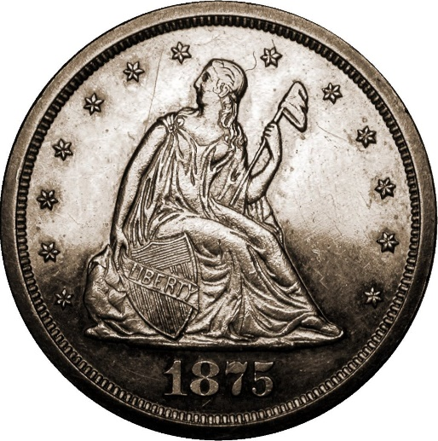
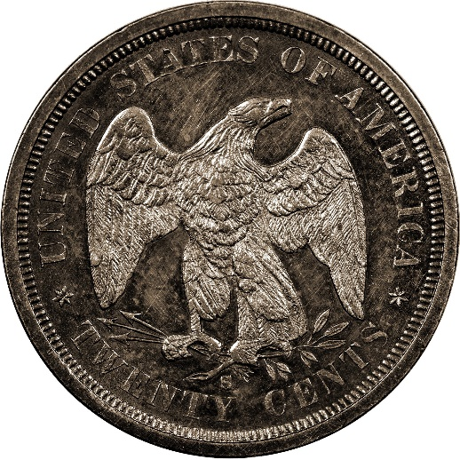
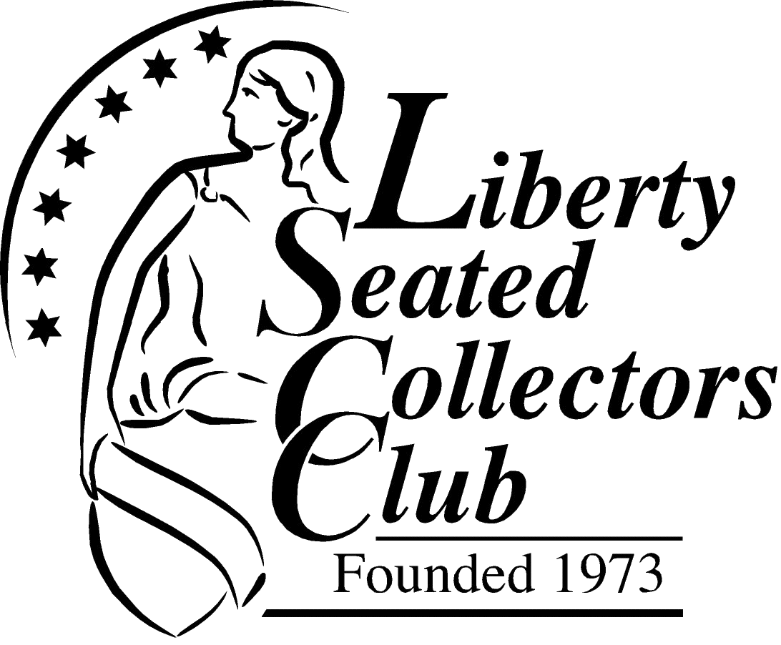
Double Dimes – and the Amazing Discovery at the Carson City Mint
John Frost
Director of Education
Notes:
This presentation will provide a brief, but thorough introduction to Twenty-cent Pieces, otherwise known in the day as Double Dimes., and then will describe a discovery at the old Carson City Mint in the late 1990s, and the role played by the twenty-cent piece and an amazing finding that occurred some years later.

Slide 2
Topics
History and design of the twenty-cent piece
The series
Collecting double dimes
Errors and Exonumia
Surprise find at the Carson City Mint
Amazing tale of discovery
Notes:
The topics for today’s presentation will include
The history of the twenty-cent piece, why it was created, and the evolution of the design, along with the public reaction
An introduction to the series itself, including the various issues, scarcity, and varieties
Some thoughts about collecting this unusual series
A quick summary of the rare twenty-cent piece errors, and some of the scarce exonumia out there
The amazing find at the Carson City Mint in the late 1990s, and finally…
A tale of discovery regarding this find that occurred years later.

Slide 3
Original proposal and later attempts
Thomas Jefferson as Chairman of the Currency Committee, proposed a Fifth or 20-cent coin as part of our national coinage
The Fifth, later called Double Disme, was debated along with the Quarter Dollar
Ultimately the Quarter was chosen
A second attempt to create the Double Dime occurred in 1806, along with a billon two-cent piece, and rejected
A third attempt was made in 1850, to attempt replacing the circulating Spanish Reale, and also rejected
Mint Act of 1873 and the Comstock Lode set the stage for another attempt
Notes:
To gain some insight on why the twenty-cent piece was created, we have to look at history that culminated with the Mint Act of 1873.
In our original coinage proposal drafted by Thomas Jefferson in 1792, the Double Disme was the proposed denomination between the Disme and the Half Dollar. Ultimately the Quarter prevailed. On several other occasions, in 1806 and 1850, the Double Dime was proposed and rejected.
In 1806, when the quarter had only been struck in 1796 and 1804, a proposal was made for a 20-cent coin (with denomination XX on the reverse), and a billon two-cent coin. The Mint Director Robert Patterson strongly opposed the 2-cent piece, and as a result, the idea for a 20-cent piece died at the same time.
In 1850, Spanish silver coins circulated freely in the United States. In an effort to urge the phase-out of these coins in favor of U.S. coins, a move was made to devalue the Spanish coins slightly, including the Reale or 2-Bit being reduced to 20 cents. Too large of a devaluation was feared, and this proposal was also rejected.
The fourth time might be the charm as we move to 1873…

Slide 4
Coins minted by U.S. Mint at start of 1873
Look at how many slots in your cash register you needed back then!
  One cent
  Two cents
  Silver three cents
  Nickel three cents
  Silver half dime
  Nickel five cents
  Dime
  Quarter
  Half dollar
  Silver dollar
  Gold dollar
  2 ½ dollars
  3 dollars
  5 dollars
  10 dollars
  20 dollars
  Trade dollar
Notes:
To gain some insight on why the twenty-cent piece was finally created, we have to look at history that culminated with the Mint Act of 1873.
To begin with, let’s look at all of the coins that the U.S. Mint struck at the beginning of 1873…
ANIMATION – step through until “20 dollars” is displayed
That’s a lot of coins! The Mint Act of 1873 did a number of things…
- It created the Trade Dollar for use in international commerce
- It abolished the 2-cent piece, the silver 3cent piece, and the silver dollar
- But it was the abolishing of the silver Half Dime that set the stage for the creation of the Twenty-cent piece

Slide 5
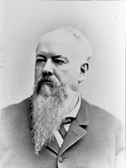
Why was the double dime created?
Nevada Senator John Percival Jones
The excuse
  Shortage of change out west, after the demise of the half dime in 1873
  Short-changing in transactions
  They didn’t make or use nickels out west
The real reason
  Silver lobby wanted to increase the amount of silver purchased by the U.S. Government (the Mint)
  Senator Jones, who made the short-changing claims, was a silver mine owner!
“The Nevada Commoner”
Notes:
Why was the double dime created? There are actually two different answers:
- there is the excuse that was provided to justify the new denomination
- and there is the real reason, and they are not necessarily the same
Both involve a man by the name of John Percival Jones, the junior Senator from Nevada, known as the “Nevada Commoner.”
The excuse was that with the 1873 elimination of the Half Dime, which circulated widely out west, there was a shortage of small change. Since nickel 5-cent coins were not used there, nor made there, a big short-changing problem occurred.
If a customer was buying a 10-cent item and paid with a Quarter, then possibly they would only get a Dime back in change, resulting in them being short-changed 5 cents. Thus a 20-cent coin would solve this problem, where a Dime as change would be the proper amount. Somehow the idea of making more Dimes didn’t come up!
The actual reason was that the single largest purchaser of silver bullion in the world was the U.S. Mint, and with the abolishing of the 3-cent silver, half dime, and silver dollar, the only way to sell the Mint more silver was a new denomination.
Senator Jones’ supporters were silver mine owners, and even Senator Jones himself had big silver interests of his own!
That’s why the 20-cent coin was really created.

Slide 6
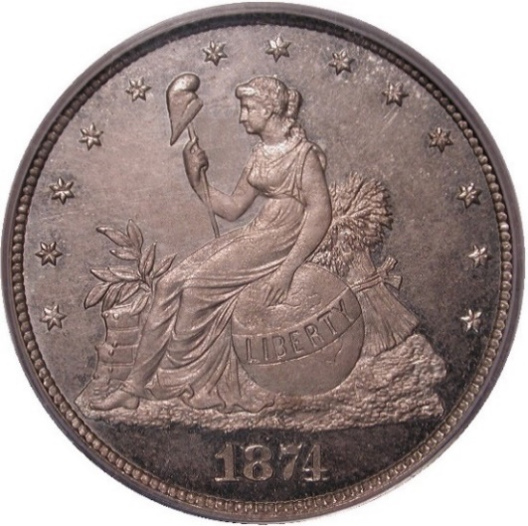
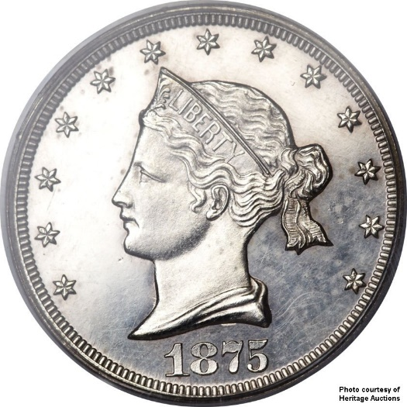
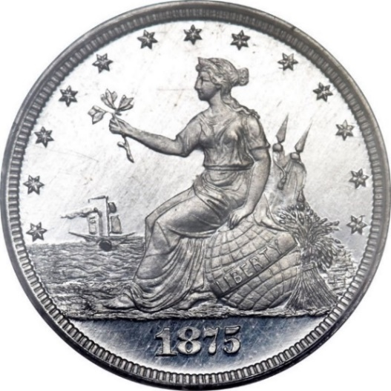
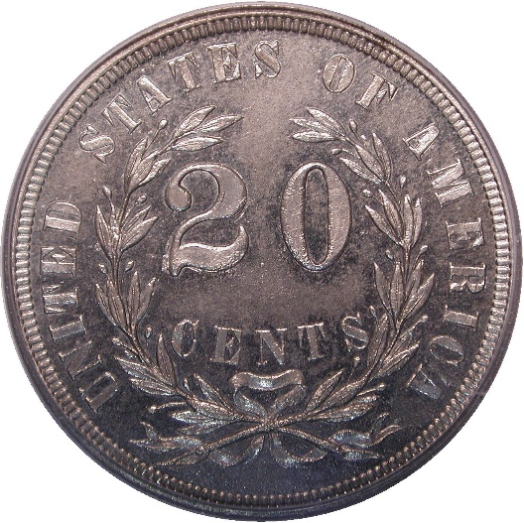
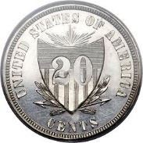
The design
Numerous patterns created in 1874 and 1875 with designs to differentiate from the quarter
Notes:
In 1874, when there was serious consideration for a new 20-cent coins, Mint Director Henry Linderman, who supported the coin, ordered a series of Patterns be created for potential design decisions.
Joseph Bailley and Chief Engraver William Barber created a number of designs for the new denomination, some quite artistic and different enough from the Quarter to be easily distinguishable.
If any of these designs had been selected, the coin might have had a decent chance, but we all know what happened.
Since Mint policy was for similar designs for different denominations within the same metal class, the classic Liberty Seated design was chosen for the obverse, and Barber’s Eagle motif from his Trade Dollar was ultimately selected.

Slide 7
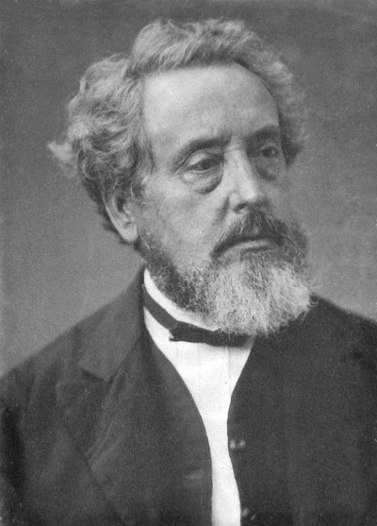
Design decision – H.R. Linderman
Chief Engraver William Barber knew the design needed to be different than the quarter
Director of the Mint H.R. Linderman overruled him and mandated the Liberty Seated design
Barber hastily engraved a Liberty Seated obverse and the rest is history
William Barber
Notes:
Because the double dime would be close to the size of the quarter, Chief Engraver William Barber and also Superintendent James Pollock knew the design needed to be substantially different than the quarter.
But the Mint Director H.R. Linderman mandated the Liberty Seated/Eagle design.
William Barber had to rush a Liberty Seated engraving to meet the coinage schedule
The rest is history

Slide 8
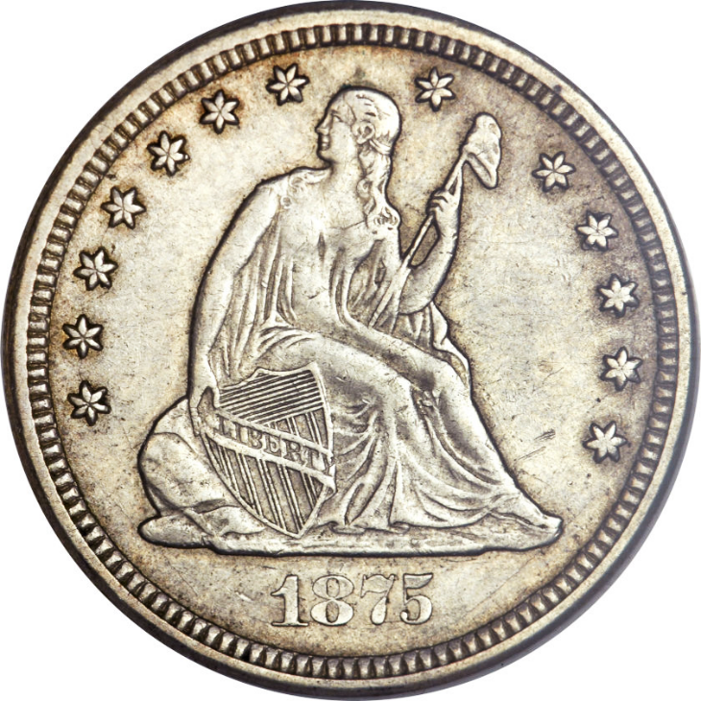
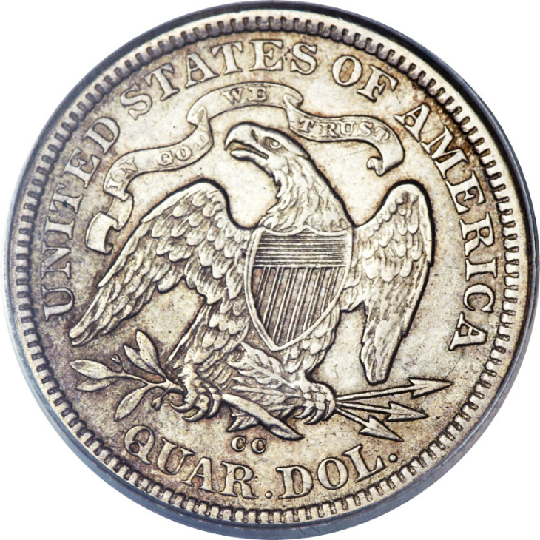
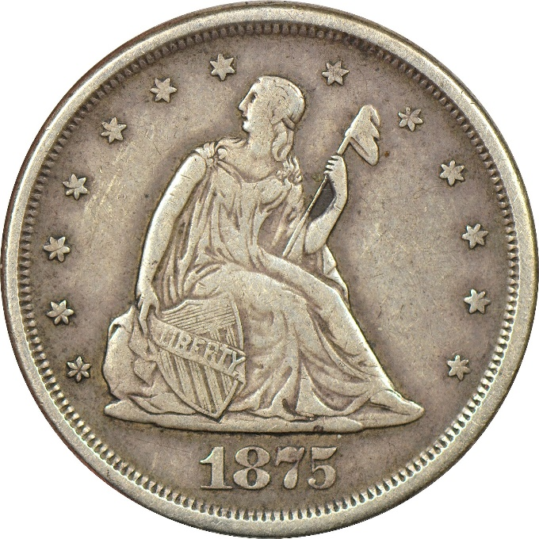
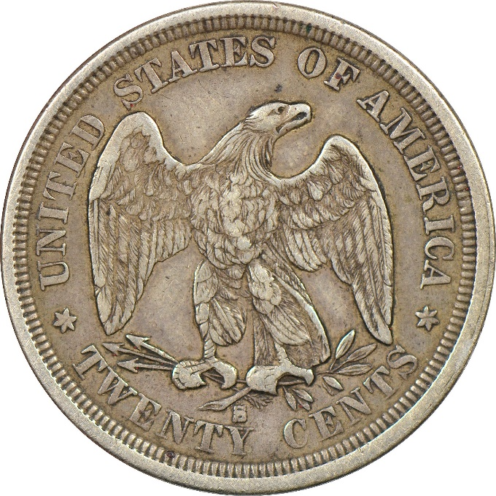
Double dimes 1875-1878
Minted for circulation for only 2 years
Plus 2 more years as proof-only issue
Biggest flop in U.S coinage history… you be the judge
Irony: this series actually caused a short-changing problem!
Notes:
The coins themselves were minted for circulation for about a year, beginning in 1875 and into early 1876. Proofs were made for collectors in 1877 and 1878 before authorization for this coin was revoked.
The twenty-cent piece was, quite simply, the biggest flop in the history of U.S. coinage.
As to why, one need only look at these photos… ANIMATION
STEP THROUGH ANIMATION ONE AT A TIME…
Quarter…..
Twenty-cent piece. [obverse]
Quarter…..
Twenty-cent piece [reverse]
OK, so the eagle faces the other direction.
How could anyone confuse these? People routinely accepted these new coins as the familiar quarter, and found later that they had short-changed themselves five cent.
ANIMATION.
The irony here is that the coin that was, in theory, created to solve a short-changing problem, actually created one!

Slide 9
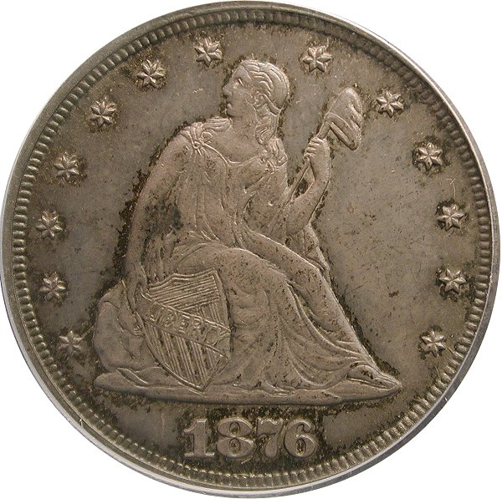
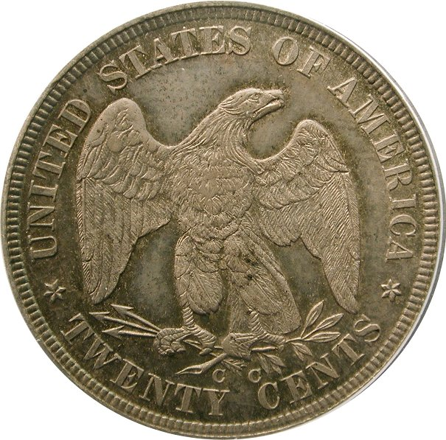
The legendary 1876-CC
One of our most famous rarities
Often thought of with the1804 dollar, 1894-S dime
10,000 ordered and minted, but never released
Some left mint as souvenirs, assay coins, or keepsakes
All still on hand ordered melted in early 1877
Fewer than 20 known
Notes:
Despite this being a very short series, there are two notable rarities.
The legendary 1876-CC twenty-cent piece, often spoken about with the likes of the 1804 dollar and 1894-S dime, didn’t start out as an extreme rarity. 10,000 were initially ordered and minted, and while not a hefty mintage, it was respectable.
However, since several thousand unissued 1875-CC coins were still on-hand, and demand had slowed to a crawl, these new 1876 coins were never released.
However, some of these new coins were purchased as souvenirs, keepsakes for the new year, or perhaps saved by people who believed the denomination wouldn’t last. Perhaps a couple of coins for assay purposes were also set aside.
Regardless, these are the only coins that left the mint, and in 1877, the Superintendent of the Mint was ordered to melt any twenty-cent pieces still on hand, which included nearly the entire production run of 1876-CC.
As a result, fewer than 20 are known today.

Slide 10
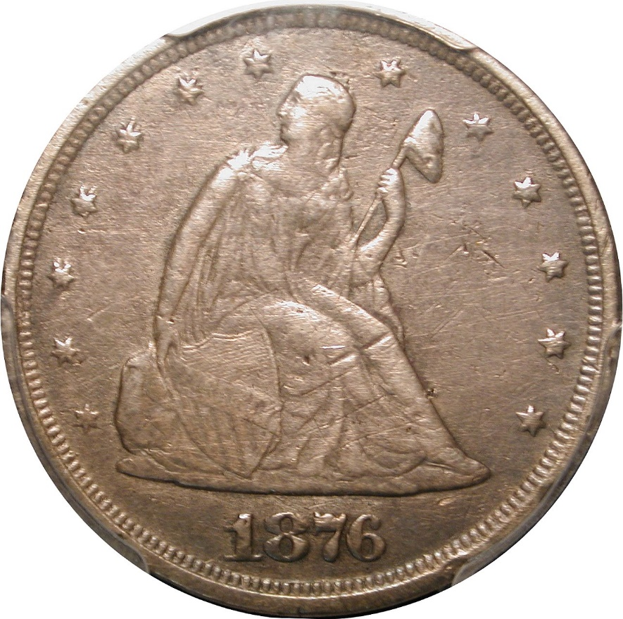
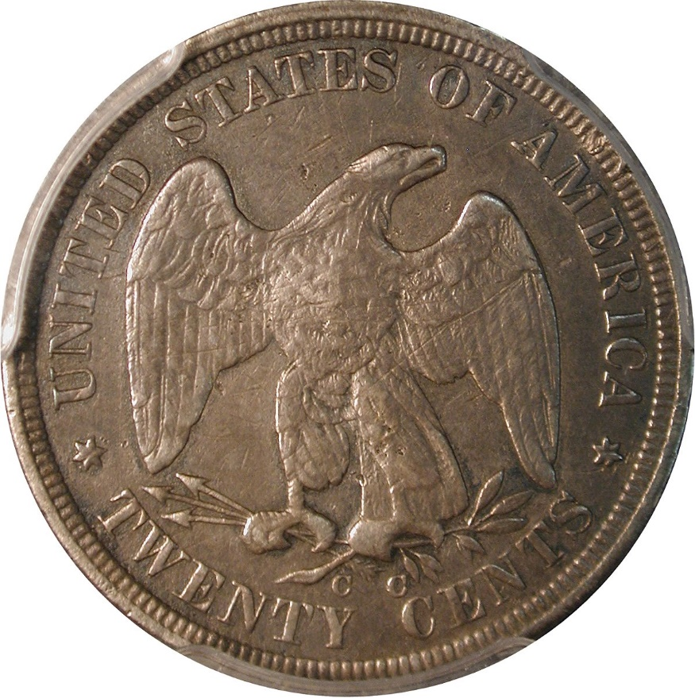
The legendary 1876-CC
Circulated examples prohibitively rare
Just 3 known circulated examples
One additional is a non-mint state uncirculated coin
The E.A. Carson Specimen – XF, scratched and polished
Notes:
Despite this being a very short series, there are two notable rarities.
The legendary 1876-CC twenty-cent piece, often spoken about with the likes of the 1804 dollar and 1894-S dime, didn’t start out as an extreme rarity. 10,000 were initially ordered and minted, and while not a hefty mintage, it was respectable.
However, since several thousand unissued 1875-CC coins were still on-hand, and demand had slowed to a crawl, these new 1876 coins were never released.
However, some of these new coins were purchased as souvenirs, keepsakes for the new year, or perhaps saved by people who believed the denomination wouldn’t last. Perhaps a couple of coins for assay purposes were also set aside.
Regardless, these are the only coins that left the mint, and in 1877, the Superintendent of the Mint was ordered to melt any twenty-cent pieces still on hand, which included nearly the entire production run of 1876-CC.
As a result, fewer than 20 are known today.

Slide 11
Series at a glance – a short set
The 1876-CC aside, the series consists of 6 coins
1875-P Mintage: 39,700
1875-CC Mintage: 133,290
1875-S Mintage: 1,155,000
1876-P Mintage: 15,900
1877-P Mintage: 350 Proofs only
1878-P Mintage: 600 Proofs only
A very reasonable set to complete
Notes:
The rare 1876-CC aside (which wasn’t a regular issue), a complete date and mintmark set consists of just 6 coins.
4 issues of circulation strikes, plus two years of proof-only issues.
As a result, a collector striving to build a complete set will have no trouble, as it is a very obtainable set, and the easiest and least costly of any other Liberty Seated series.
By far, the highest mintage was in San Francisco, with over one million struck, 1875-CC also had a high mintage, but much less than 1875-S.
The two Philadelphia issues of 1875 and 1876 had small mintages and represent scarcest of the circulation strikes.

Slide 12
Collecting 20-cent pieces
Seems like 99% of collectors do this series by type
The initial issue, 1875-S with mintage over 1.15 million, is dirt common and is the usual type coin
1875 and 1876 (Philadelphia) have a combined mintage of just 53,000
1875-CC not as hard to find, but much more expensive
1877 and 1878 proofs are tough coins, but do appear from time to time, usually at auction
Notes:
The majority collect 20-cent pieces by Type, that is they wish to have a single example, along with a 2-cent piece, silver 3-cent piece, and nickel 3-cent piece.
Most collectors choose the 1875-S as a type coin, as it is the most common, least expensive, and available in any grade, including mint state.
Carson City collectors invariably choose the 1875-CC, as the only collectable issue from that mint, and it is less common than the 1875-S.
A few collectors choose one of the scarce Philadelphia issues, with a much lower mintage and survival. The added bonus is that either 1875 or 1876 costs less than the much more common 1875-CC.

Slide 13

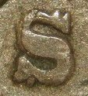

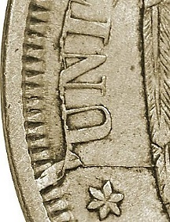
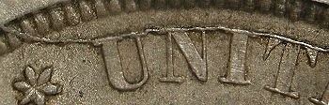
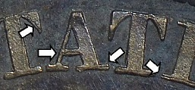
Varieties
6 misplaced dates
4 repunched mintmarks
2 doubled dies
28 die marriages
    27 excluding 1876-CC
Major die cracks, cud
Notes:
For such a short series, there a lot of varieties.
- 6 misplaced dates
- 4 repunched mintmarks
- 2 doubled dies
All from just two years of business strikes!
All in all, a total of 28 die marriages are known for all the issues, 27 if the 1876-CC is excluded.
Some of the dies developed extensive or major die cracks, and even one die results in a cud.

Slide 14
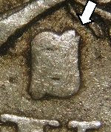
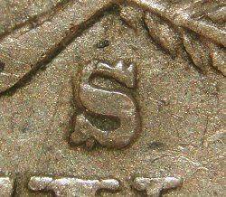
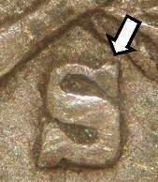
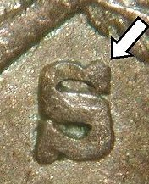
Repunched mintmarks
Four repunched S/S mintmarks are known
One obvious, and the rest are very minor
1875-S, S/S or $ variety
Notes:
Four of the S reverses have repunched mintmarks.
Most are minor (as shown), but one of them is more significant and is sometimes referred to as the “$” variety.

Slide 15
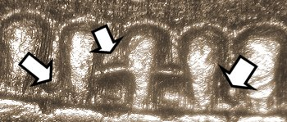
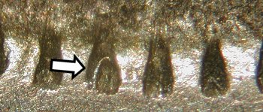
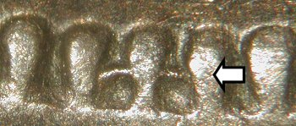
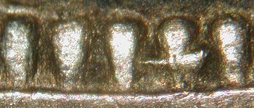
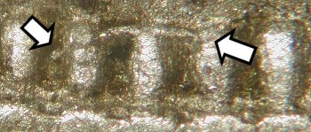
Misplaced dates
At least 6 obverses have digits “misplaced” in the denticles below the date
Notes:
Six of the obverse dies had misplaced date digits, where the tops of digits are visible in the denticles below the actual date.
The top right shows the top of an 8 midway in the dentcles
Middle left shows another 8 midway in the denticles
Lower left show the top of an 8 at the top of the denticles
Top right shows still another 8 (stretched by die wear)
Middle right shows the top of a 5 in the denticles
All of these are from 1875-S dies.
The lower right shows the top of an 8 and the upper left point of a 7 in the denticles, this from an 1876-CC.

Slide 16
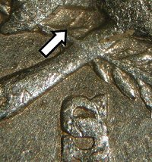
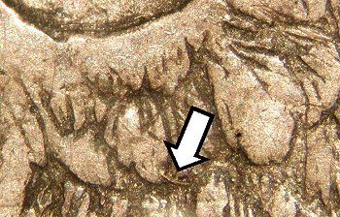
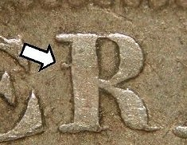
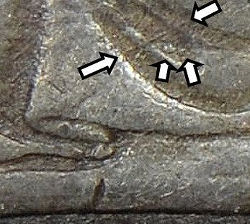

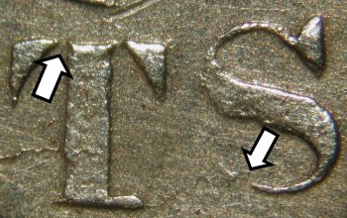
Die markers
Date and mintmark positions, die scratches, gouges, lines, repunched mintmarks and misplaced date digits
Notes:
In performing die studies (to catalog each die and die combination in striking this series, we look for “Die Markers” to distinguish one die from another.
Die markers can include date and mintmark positions, die scratches or gouges, die lines, lumps, die cracks, or other attributes.
Looking left to right,, we see
A diagonal die line
A die scratch in the eagle’s wing
A knob attached to the R in AMERICA
Disconnected serifs from overpolishing the die before use
Diagonal die line, and a couple of lumps
A minor doubled die revers

Slide 17
Die marriages
By studying details of thousands of coins, we can identify distinctly different obverse and reverse dies
A combination of a specific obverse die with a specific reverse die is called a marriage
Date | Obverses | Reverses | Marriages
1875-P | 2 | 2 | 2
1875-CC | 2 | 4 | 5
1875-S | 11 | 10 | 16
1876-P | 3 | 3 | 4
1876-CC | 1 | 1 | 1
1877 | 1 | 1 | 1
1878 | 1 | 1 | 1
Notes:
Studying all of the known dies and combinations, we arrive at the number of die marriages known for each issues.
1875-P used 2 obverses and 2 reverses in 2 combinations/marriages
1875-CC used 2 obverses and 4 reverses in 5 marriages
1875-S had 11 obverses, 10 reverses, in 16 marriages
1876-P had 2 obverses, 1 reverse, for 2 marriages
And the rest only used a single pair of dies – one marriage each.

Slide 18
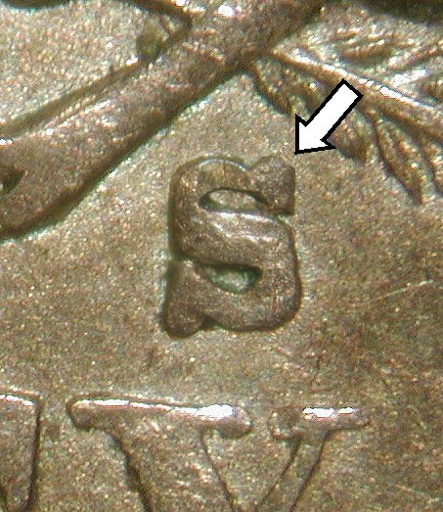
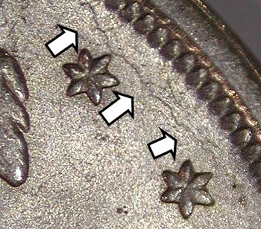
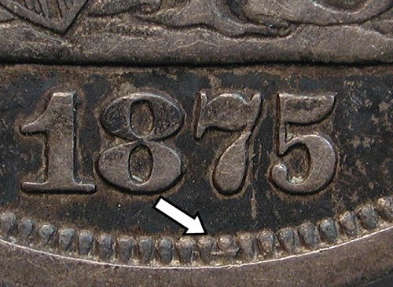
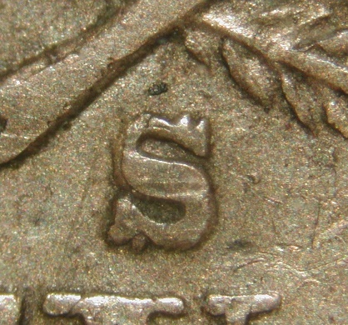
The really geeky stuff – Part 1
Die emission sequencing
  Sometimes swapping out one die at a time!
  Progression of die cracks
  Sharpness of die gouges lessens with die wear
  Even a re-marriage!
11 11 11
B → J → B

Slide 19
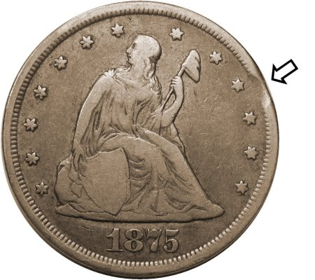
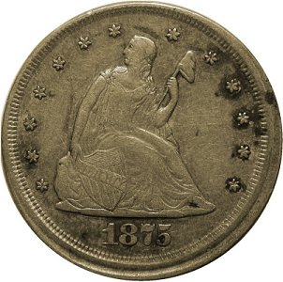
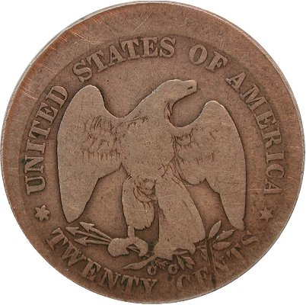
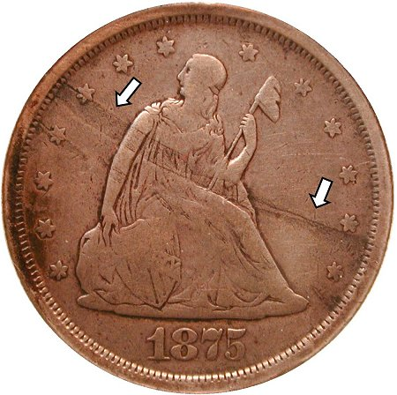
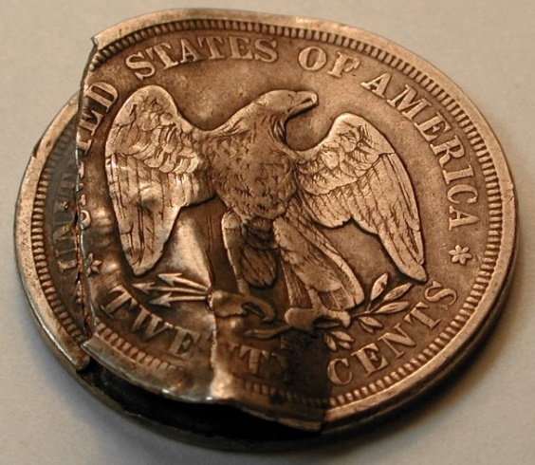
Errors – all rare
Clips, broadstruck, off-center, double-struck, laminations, and more!
Notes:
Errors of all Liberty Seated coinage are very scarce, but on the short-lived 20-cent piece, they are rare. The denomination simply didn’t last long enough to create many errors.
Errors show here include (left to right)
- Partial collar
- off-center or uncentered broadstrike
- minor clip
- lamination
- clamshell error, a major split planchet

Slide 20
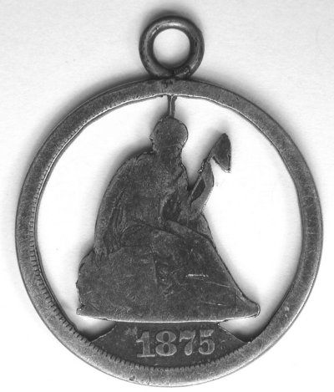
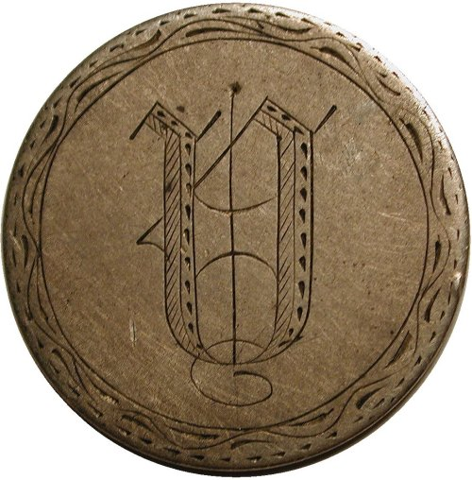
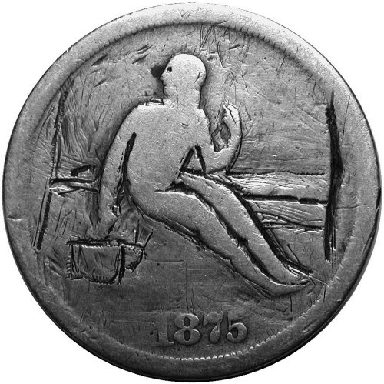
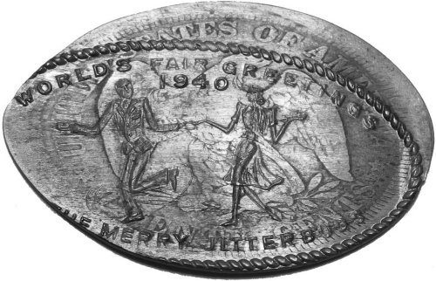
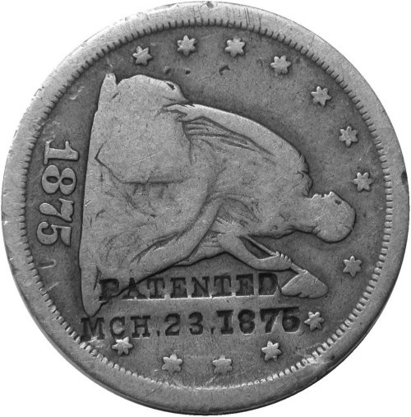


Exonumia – all very scarce to rare
Love tokens, counterstamps, elongates, cufflinks and buttons, “potty” coins
Notes:
Exonumia, such as love tokens, buttons, etc., are commonly found on Liberty Seated dimes, and sometimes on half dimes and quarters, but seldom on 20-cent pieces.
Again, this is mostly due to the short timespan of the series.
Pictured here (left to right) are
A simple love token
A “potty” coin, engraved in an unflattering manner!
Elongated coin
Cut-out 20-cent piece
Counterstamp
Very ornate love token
Cufflinks made from 20-cent pieces

Slide 21
Amazing Discovery at the Carson City Mint
Notes:
And now, the amazing find at the Carson City Mint

Slide 22

Carson City Mint –
Now the Nevada State Museum
In 1999, the Nevada State Museum was landscaping…
While digging, they discovered a pit…
Notes:
The original Carson City Mint still stands today, and is now home to the Nevada State Museum, at 600 Carson Street in Nevada’s capital city.
In 1999, the Museum was expanding, and in doing so, the excavating discovered a pit.
In this pit, they found….

Slide 23

A pit full of dies!
Notes:
Discarded coinage dies!
Hundreds of them cancelled and buried underground.
Fortunately, the excavator collected coins, and he knew what he was looking at.
They stopped digging and called the Museum’s Curator and Archeologist to the scene, and they began a careful recovery effort.

Slide 24

Excavator knew about coins
Notes:
The dies were in all sorts of conditions. Some were in fairly good shape, others highly encrusted, and many clumped together.

Slide 25

The excavation
Notes:
The recovery efforts carefully removed the dies, sometimes in large clumps.

Slide 26

He knew what he was looking at!
Notes:
As these were buried for over 120 years, some of the dies were in remarkable shape.
And nobody knew they were there!

Slide 27

Carson City Mint visit – July 2013
Examined cancelled dies discovered discarded in pit
They talked about their “secret process” to restore the dies…
A six-month soak in…
WD40
Notes:
Many of the dies were heavily encrusted, and a long restoration and curating process began.
To get the encrustation off the dies in a safe manner, these dies were soaked for 6 months in WD-40!
They would soak the dies, and after a month, they rapped the shaft of the die with a hammer (dislodging the loosened encrustation), and then back in the WD-40

Slide 28

Carson City Mint visit
Notes:
During a visit to the Nevada State Museum in 2013, the dies in various stages of restoration, were brought out for examination and photography.
These included many dies of various denominations, from Dime to Double Eagle.

Slide 29

The goodies!
Notes:
Here is a photo of some of the restored dies.
From left to right:
Liberty Seated dime obverse
Trade Dollar obverse
Seated half obverse
Double Eagle obverse
Trade Dollar reverse
The deep cuts on the dies are cancellation marks, placed in the dies so that they could not be used in the future for copies or striking of counterfeits.

Slide 30

The goodies!
Notes:
Close-up of the Trade Dollar reverse, the CC mintmark still showing

Slide 31



Carson City Mint visit – July 2013
Examined four cancelled 20-cent piece dies
Two were completely effaced
The other two dies did not match any of the known coins
Notes:
A visit was made to the Nevada State Museum in July 2013, and the dies were made available for examination.
There were 4 dies for twenty-cent pieces recovered.
Two of them were so badly rusted/corroded, that no design details remained at all – they were completely obliterated
Two of them, however, 1 obverse and 1 reverse, did have enough design remaining to examine.
After their recovery and restoration, it had been confirmed that neither the 1876 obverse die, nor the CC reverse die, matched any of the known coins.
The 1876 obverse die recovered did not have the die doubling or date position of the rare 1876-CC coins, and the CC mintmark position on the reverse die did not match any known 1875-CC or 1876-CC coins.
Both of these dies had been assumed to be unused dies that were merely cancelled and discarded.

Slide 32



A tale of discovery
August 2013 ANA in Chicago/Rosemont
  Student asked “How many die pairs for the 1875-CC?”
  “2 of course”
  “Nope, 3. I think this is a different die! I think the mintmark is in a different place”
  He was right
Close CC Wide CC
The new one!
Notes:
A month later, at the 2013 ANA World’s Fair of Money, a collector and graduate student heard that Lane Brunner and John Frost of the LSCC were writing the reference on 20-cent pieces. An avid Double Dime fan, the collector thought he had found something, and asked, “How many die pairs were used for the 1875-CC 20-cent piece?”
At the time, after a collective 50 years experience in the series, both Lane and John (and most other folks) had only seen two pairs of dies, in two combinations. So the reply was, “Two of course.”
He responded, “No, three! I think I have found a different reverse die, as I think the mintmark is in a different place.”
He asked John to examine it, and he took the coin and closely looked at it, and he was right! In addition to the two-known reverses:
- Close CC, first C high and left of the 2nd portion of the arrow feather
- Wide CC, with the first C further left, and the second C further right
This new one was also a Close CC, but with the C’s lower that the other one, with the first C below the 2nd portion of the arrow (not to the left of it)
Thus, it had to be a new die!

Slide 33


The “new” 1875-CC Reverse
The coin first got his attention not because of the mintmark position…
It was severe die cracks that caught his eye
This seems to be a rare variety
    Presently 11 known
Notes:
The new “Low Close CC” reverse first got the collector’s attention because of dramatic die cracks, especially at TWENTY, but actually all over the reverse.
Because he had never seen any severe die cracks on any 1875-CC, that is when he took a closer look at the mintmark and noticed it was in a slightly different position.
Of course, a number of Double Dime collectors began looking for this new reverse, the authors included. But work continued on the book.

Slide 34

September 2013 –
While working on the book…
I was writing up the new reverse 1875-CC die
I was also remembering my visit to Carson City
I thought back to the CC dies that I had seen in July
Notes:
A month later, working at home on the book, and drafting the story of the discovery of the new die, John also remembered the visit to Carson City he had made that summer. Specifically he thought about the dies he had examined and photographed there.
Pictured here are both the Obverse and Reverse 20-cent dies that were found.
Neither die matched any known coins. BUT…. That was then.

Slide 35


September 2013 –
Re-examined the die
We have a newly-discovered reverse to consider
Could the die possibly match the new reverse???
This coin was struck by this die! Conclusive!
Notes:
Now we had a coin with a newly-discovered reverse die to consider. Could it possibly be?
John dug out his example of the new reverse (he had found one), and the photo of the reverse die taken from the visit to Carson City, and lo and behold!
The photo of the die shows very clearly the Die Crack that also appears on the coin. The Die of course, is a reverse image of the coin.
THE SLIDE HAS ANIMATION TO REVERSE THE DIE PHOTO
And now the match is easy to see.
The location of the two Cs in the mintmark also match.
Now we had conclusive evidence that this discarded die did, in fact, strike coins, as we had a definitive match.
The authors later determined that this cracked die was also the first reverse die used that year, and was quickly replaced after cracking so bad,

Slide 36

The really geeky stuff – Part 2
1875-CC die marriage sequencing
  Sharpness of die gouges over time in different marriages
  Replacing 1 die at a time
  Examining all 5 combinations

Slide 37






The really geeky stuff – Part 2
1875-CC die marriage sequencing
1 2 3
4
5
The recovered CC reverse die was the first one used!

Slide 38

Beginning August 21, 2015…
Notes:
A plug for the Nevada State Museum and the Carson City Mint…
If you are ever in the greater Reno-Lake Tahoe-Carson City area, or even the Sacramento area (2-1/2 hours away), you should seriously consider a visit to the fabled Carson City Mint sometime.
The exhibits are fabulous, the staff incredibly helpful.

Slide 39

Special exhibit at
Nevada State Museum
Exhibit includes, side-by-side…
    the recovered reverse die, 1875-CC Reverse A
    example of the 1875-CC BF-1 coin struck by that die
Exhibit will remain a year or more
Notes:
Now we had a coin with a newly-discovered reverse die to consider. Could it possibly be?
John dug out his example of the new reverse (he had found one), and the photo of the reverse die taken from the visit to Carson City, and lo and behold!
The photo of the die shows very clearly the Die Crack that also appears on the coin. The Die of course, is a reverse image of the coin.
THE SLIDE HAS ANIMATION TO REVERSE THE DIE PHOTO
And now the match is easy to see.
The location of the two Cs in the mintmark also match.
Now we had conclusive evidence that this discarded die did, in fact, strike coins, as we had a definitive match.
The authors later determined that this cracked die was also the first reverse die used that year, and was quickly replaced after cracking so bad,

Slide 40


Die and coin reunited!
Just past the Nevada Ghost Town exhibit, to the right

Slide 41

Die and coin reunited!
On your way to Press #1 striking medals

Slide 42

Comprehensive reference
Reference book www.doubledimes.com
179 pages, spiral bound Web book available at no cost
Nearly 400 photos Excellent for use at coin shows
Notes:
The comprehensive reference for 20-cent pieces is a book, published in 2014, Double Dimes – The United States Twenty Cent Piece. With 179 pages, and 400 photos, it covers all known die marriages, along with the history and public reaction of the series, errors, exonumia, and pretty much everything you want to know about this short-lived series.
There is a web edition of the book, completely free of charge, at www.doubledimes.com. The website has he complete content of the book.

Slide 43

Double Dime Summit – July 2013
Over 650 20-cent pieces examined over 7 days
Collective research aggregated and organized
Notes:
This photo shows what the authors called the Double Dime Summit, held during the summer of 2013. The authors collated their individual research, cataloged die marriages and emission sequence.
Over the course of 7 days, the authors completely immersed themselves in double dimes, with more than 650 examples available to combine their knowledge into a single set, and confirm their findings.
It’s possible that there haven’t been that many double dimes together in one place since they left the mint!

Slide 44
Summary
20-cent coins were born of politics and were a failure waiting to happen, from the very beginning
They form a most unusual part of our coinage history
The series is short and underappreciated, but contains one of the truly legendary U.S. coins of all time
The “complete” set consists of just 6 coins, and none of those collectible coins is a complete budget buster
Building a complete 29-coin die marriage set is doable
Finally, a good reference is available to help you do it
20-cent coins play an interesting role in the dies discovered in Carson City
Notes:
To summarize, 20-cent pieces were a creation of politics, and were a fiasco from the beginning, It’s demise after a short time was inevitable.
Because of that, they form a curious piece of our coinage history.
While this short series is usually neglected and overlooked by collectors, it is best known for one of the legendary rarities in all of U.S. coinage.
For those who strive for a complete set of all regular issues, there are just six coins needed, and all of them are obtainable, and none of them are complete budget-busters.
Even a complete Die Marriage set consists of just 27 coins, which is very manageable to the variety collector. While representing a good challenge, the coins are out there to find, because few people are looking for them (so far).
There is finally a good reference to help you out
And the twenty-cent dies discovered buried next to the Carson City Mint played an interesting role, in that there was finally a match between one of the dies and the physical coin that was struck by it.

Slide 45
Photo credits
Photo of Senator John Percival Jones provided by the U.S. Senate Historical Office
Photos of the 1875 Patterns provided by Heritage Auctions
The 4 photos of the die excavation were provided by the Nevada State Museum
All other photos by author and speaker John Frost
Notes:
To summarize, 20-cent pieces were a creation of politics, and were a fiasco from the beginning, It’s demise after a short time was inevitable.
Because of that, they form a curious piece of our coinage history.
While this short series is usually neglected and overlooked by collectors, it is best known for one of the legendary rarities in all of U.S. coinage.
For those who strive for a complete set of all regular issues, there are just six coins needed, and all of them are obtainable, and none of them are complete budget-busters.
Even a complete Die Marriage set consists of just 27 coins, which is very manageable to the variety collector. While representing a good challenge, the coins are out there to find, because few people are looking for them (so far).
There is finally a good reference to help you out
And the twenty-cent dies discovered buried next to the Carson City Mint played an interesting role, in that there was finally a match between one of the dies and the physical coin that was struck by it.

Slide 46


Liberty Seated Collectors Club
Founded during 1973 in Bal Harbour, Florida
Kam Ahwash and John McCloskey past presidents
650+ members who enjoy seated coinage
Liberty Seated coinage experts
Research, education and social interactions
~ 20 Regional Meeting events per year
Notes:
The LSCC has been a vibrant club for more than 40 years, when Kam Ahwash and a few other collectors and dealers of Liberty Seated coinage realized the need for a specialty club to educate the collectors of the rich series of Liberty Seated coinage.
Today, the LSCC has well over 600 members all over the country. Members include a wide range, including the recognized experts in the different series, beginning collectors, and everything in between. And the experts are only too happy to share their knowledge with others. If one thing sets the LSCC apart, it is a very welcoming organization.
The LSCC provides its members research information, a formal education program, meetings and social events all over the country. We currently have about 20 meetings and social events annually, mostly at regional coin shows.
Dues are $20 per year
Our officers for 2014-2015 include President Gerry Fortin, VP Len Augsburger, and Secretary/Treasurer Craig Eberhart. Our Publications Editor is Bill Bugert, who publishes two award-winning publications: The Gobrecht Journal, and the monthly electronic E-Gobrecht.

Slide 47

Award-winning Publications
Gobrecht Journal
Published 3 times per year
Bill Bugert, Editor
Detailed Research, Collecting Notes, Club Member Stories
All Color
E-Gobrecht
Published Monthly
Bill Bugert, Editor
Club News, Auction Results. Short Articles, Monthly Columns
Online archives of 10+ years
Notes:
The primary publication is The Gobrecht Journal. 3 issues are published each year, and includes most of the research articles written by members, along with anecdotes and collecting notes. Beginning in November 2014, the Gobrecht Journal is an all-color publication.
The monthly E-Gobrecht is available by email or download from our website, lsccweb .org. The E-Gobrecht contains more time-sensitive items, such as club news, auction results, discovery announcements, and a few monthly columns.
An archive of past issues, for more than 10 years, is also available from the LSCC website.
If you are not receiving the E-Gobrecht and you would like to, just give us your email address and we’ll take care of that for you.

Slide 48
www.LSCCweb.org
Thank you!
Any questions?
Notes:
Any questions?

